Slide 1
Inverse Normal calculations
LO: Given the percentage area under the curve, find the value corresponding to it
To find the mean and standard deviation.

Slide 2
Inverse normal calculations
Sometimes you are given the percentage area under the curve, i.e. the probability or the proportion, and you are asked to find the value corresponding to it. This is called an inverse normal calculation.
Always make a sketch to illustrate the information given.
You must always remember to use the area to the left when using your GDC. If you are given the area to the right of the value, you must subtract this from 1 (or 100%) before using your GDC.
95%
5%
For example, an area of 5% above a certain value means there is an area of 95% below it.
You can use the GDC to find this value. The calculator has a function called inverse Normal which will do this.

Slide 3
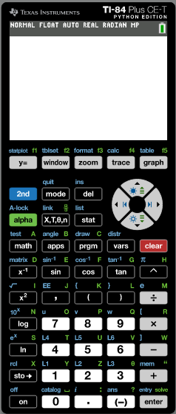
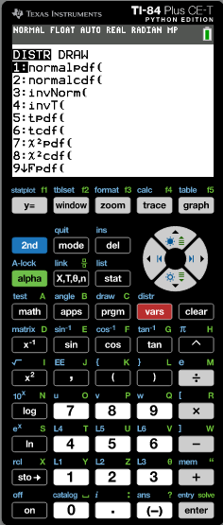
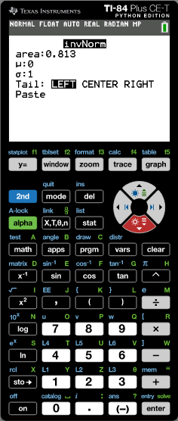
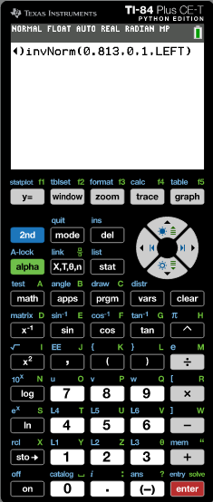
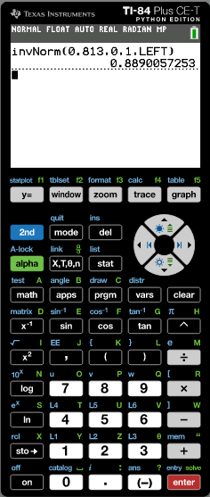
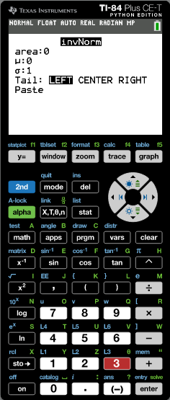
Inverse normal calculations
In these examples we will return to the standard normal distribution Z ~ N(0, 1).
Given that Z ~ N(0, 1) use your GDC to find a.
P (Z < a) = 0.813.
Step 1:
Draw a sketch
Step 2:
Use your GDC
f(z)
Turn on the GDC
Tap on
0.813
Tap on
invNorm(
Type in the data
a
z
Area: 0.813
0
μ: 0
σ: 1
Tail: Left:
Paste
The value of a is 0.889

Slide 4
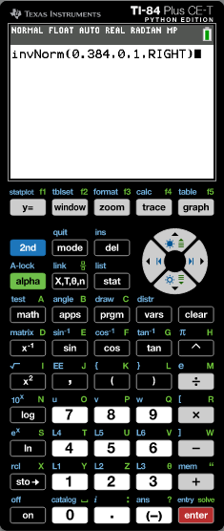
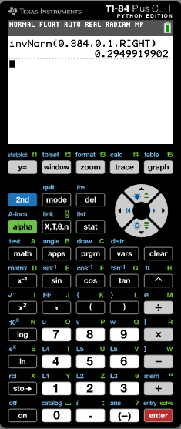
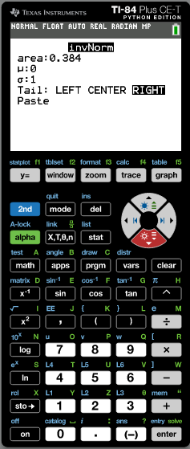
Inverse normal calculations
In these examples we will return to the standard normal distribution Z ~ N(0, 1).
Given that Z ~ N(0, 1) use your GDC to find a.
P (Z > a) = 0.384.
Step 1:
Draw a sketch
Step 2:
Use your GDC
f(z)
Turn on the GDC
Tap on
Tap on
invNorm(
0.384
Type in the data
a
z
Area: 0.384
0
Notice that the area for P(Z > a) = 0.384 is in the right side of the curve
μ: 0
σ: 1
Tail: Right:
Paste
The value of a is 0.295

Slide 5
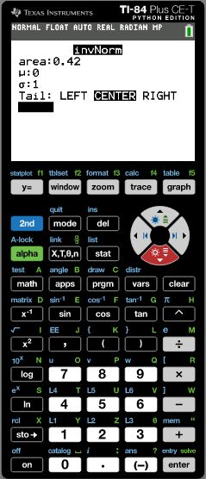
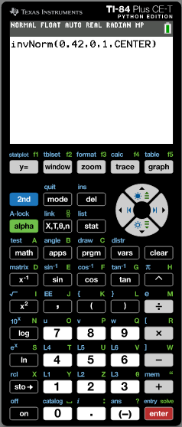
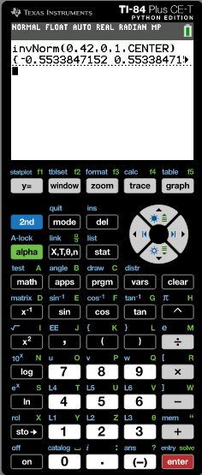
Inverse normal calculations
In these examples we will return to the standard normal distribution Z ~ N(0, 1).
Given that Z ~ N(0, 1) use your GDC to find a.
P (–a < Z < a) = 0.42.
Step 1:
Draw a sketch
f(z)
Step 2:
Use your GDC
Turn on the GDC
Tap on
0.42
Tap on
invNorm(
–a
a
z
Type in the data
0
Area: 0.42
μ: 0
σ: 1
Tail: center:
Paste
The value of –a is –0.553
The value of a is 0.553

Slide 6
Inverse normal calculations
The volume of cartons of milk is normally distributed with a mean of 995ml and a standard deviation of 5ml.
10% of cartons are rejected for containing to little milk. Find the minimum volume, to the nearest ml, that a carton must contain if it is to be accepted.
Sketching the normal distribution diagram gives a clear idea of what is happening.
The shaded area represents 10% of the cartons.
995
Turn on the GDC

Slide 7
Inverse normal calculations
The volume of cartons of milk is normally distributed with a mean of 995ml and a standard deviation of 5ml.
10% of cartons are rejected for containing to little milk. Find the minimum volume, to the nearest ml, that a carton must contain if it is to be accepted.
Sketching the normal distribution diagram gives a clear idea of what is happening.
The shaded area represents 10% of the cartons.
995
tap
invNorm(

Slide 8
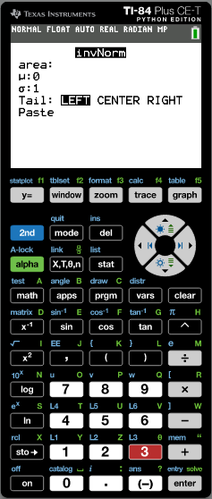
Inverse normal calculations
The volume of cartons of milk is normally distributed with a mean of 995ml and a standard deviation of 5ml.
10% of cartons are rejected for containing to little milk. Find the minimum volume, to the nearest ml, that a carton must contain if it is to be accepted.
Sketching the normal distribution diagram gives a clear idea of what is happening.
The shaded area represents 10% of the cartons.
Now type the information from the problem:
995
Area: 0.1
μ: 995
σ: 5
Tail: Left:
Paste

Slide 9
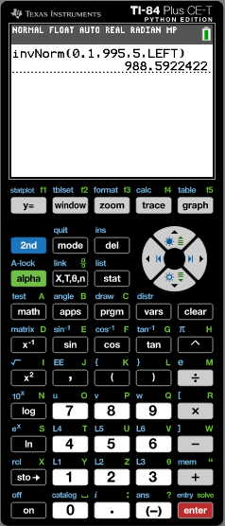
Inverse normal calculations
The volume of cartons of milk is normally distributed with a mean of 995ml and a standard deviation of 5ml.
10% of cartons are rejected for containing to little milk. Find the minimum volume, to the nearest ml, that a carton must contain if it is to be accepted.
Sketching the normal distribution diagram gives a clear idea of what is happening.
The shaded area represents 10% of the cartons.
995
The solution on the calculator is 988.5922422
So the minimum volume is 989ml to the nearest ml.

Slide 10
Example 2
The weights of pears are normally distributed with a mean of 110g and a standard deviation of 8g.
Find the percentage of pears that weigh between 100g and 130g.
It is known that 8% of the pears weigh more than m g. Find the value of m.
250 pears are weighed. Calculate the expected number of pears that weigh less than 105g.
μ
110
Sketch a diagram. μ = 110g σ = 8g
μ – σ
102
μ + σ
118
μ - 2σ
94
μ + 2σ
126
μ - 3σ
86
μ + 3σ
134

Slide 11
Example 2
The weights of pears are normally distributed with a mean of 110g and a standard deviation of 8g.
Find the percentage of pears that weigh between 100g and 130g.
Sketch a diagram. μ = 110g σ = 8g
μ
110
μ – σ
102
μ + σ
118
μ - 2σ
94
μ + 2σ
126
μ - 3σ
86
μ + 3σ
134
Turn on the GDC

Slide 12
Example 2
The weights of pears are normally distributed with a mean of 110g and a standard deviation of 8g.
Find the percentage of pears that weigh between 100g and 130g.
Sketch a diagram. μ = 110g σ = 8g
μ
110
μ – σ
102
μ + σ
118
μ - 2σ
94
μ + 2σ
126
μ - 3σ
86
μ + 3σ
134
tap
Normalcdf(

Slide 13
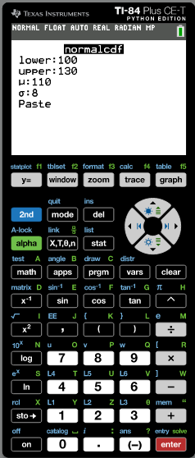
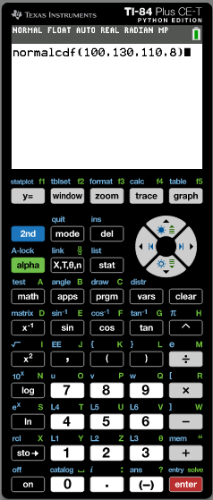
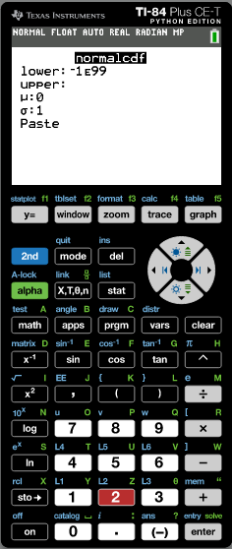
Example 2
The weights of pears are normally distributed with a mean of 110g and a standard deviation of 8g.
Find the percentage of pears that weigh between 100g and 130g.
Sketch a diagram. μ = 110g σ = 8g
μ
110
μ – σ
102
μ + σ
118
μ - 2σ
94
μ + 2σ
126
μ - 3σ
86
μ + 3σ
134
Type the information from the problem:
Lower: 100
Upper: 130
μ: 110
σ: 8

Slide 14
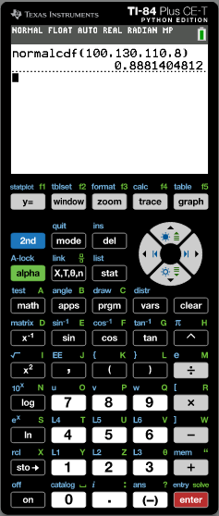
Example 2
The weights of pears are normally distributed with a mean of 110g and a standard deviation of 8g.
Find the percentage of pears that weigh between 100g and 130g.
88.8%
Sketch a diagram. μ = 110g σ = 8g
μ
110
μ – σ
102
μ + σ
118
μ - 2σ
94
μ + 2σ
126
μ - 3σ
86
μ + 3σ
134
The solution on the calculator is 0.8881404612
So the percentage of pears that weigh between 100g and 130g is 88.8%

Slide 15
Example 2
The weights of pears are normally distributed with a mean of 110g and a standard deviation of 8g.
Find the percentage of pears that weigh between 100g and 130g.
It is known that 8% of the pears weigh more than m g. Find the value of m.
88.8%
Sketch a diagram. μ = 110g σ = 8g
μ
110
μ – σ
102
μ + σ
118
μ - 2σ
94
μ + 2σ
126
μ - 3σ
86
μ + 3σ
134
8%
Tap on

Slide 16
Example 2
The weights of pears are normally distributed with a mean of 110g and a standard deviation of 8g.
Find the percentage of pears that weigh between 100g and 130g.
It is known that 8% of the pears weigh more than m g. Find the value of m.
88.8%
μ
110
Sketch a diagram. μ = 110g σ = 8g
μ – σ
102
μ + σ
118
μ - 2σ
94
μ + 2σ
126
μ - 3σ
86
μ + 3σ
134
8%
Tap on
invNorm(

Slide 17
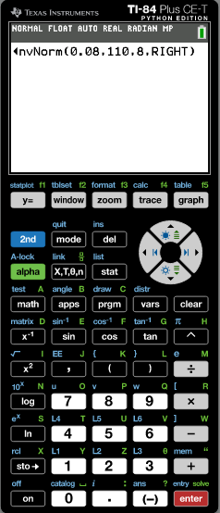
Example 2
The weights of pears are normally distributed with a mean of 110g and a standard deviation of 8g.
Find the percentage of pears that weigh between 100g and 130g.
It is known that 8% of the pears weigh more than m g. Find the value of m.
88.8%
Sketch a diagram. μ = 110g σ = 8g
μ
110
μ – σ
102
μ + σ
118
μ - 2σ
94
μ + 2σ
126
μ - 3σ
86
μ + 3σ
134
8%
Type the information from the problem:
Area: 0.8
μ: 110
σ: 8
Tail: Right:
Paste

Slide 18
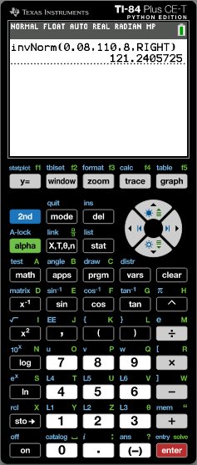
Example 2
The weights of pears are normally distributed with a mean of 110g and a standard deviation of 8g.
Find the percentage of pears that weigh between 100g and 130g.
It is known that 8% of the pears weigh more than m g. Find the value of m.
88.8%
121g
Sketch a diagram. μ = 110g σ = 8g
μ
110
μ – σ
102
μ + σ
118
μ - 2σ
94
μ + 2σ
126
μ - 3σ
86
μ + 3σ
134
8%
The solution on the calculator is 121.2405725
So m = 121g (to 3 sig. fig.)

Slide 19
Example 2
The weights of pears are normally distributed with a mean of 110g and a standard deviation of 8g.
Find the percentage of pears that weigh between 100g and 130g.
It is known that 8% of the pears weigh more than m g. Find the value of m.
88.8%
c) 250 pears are weighed. Calculate the expected number of pears that weigh less than 105g.
121g
Sketch a diagram. μ = 110g σ = 8g
μ
110
μ – σ
102
μ + σ
118
μ - 2σ
94
μ + 2σ
126
μ - 3σ
86
μ + 3σ
134
Tap on

Slide 20
Example 2
The weights of pears are normally distributed with a mean of 110g and a standard deviation of 8g.
Find the percentage of pears that weigh between 100g and 130g.
It is known that 8% of the pears weigh more than m g. Find the value of m.
88.8%
c) 250 pears are weighed. Calculate the expected number of pears that weigh less than 105g.
121g
Sketch a diagram. μ = 110g σ = 8g
μ
110
μ – σ
102
μ + σ
118
μ - 2σ
94
μ + 2σ
126
μ - 3σ
86
μ + 3σ
134
tap
Normalcdf(

Slide 21
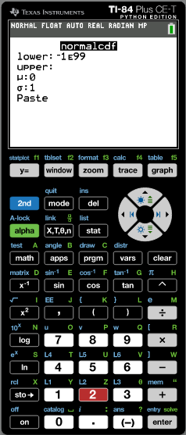
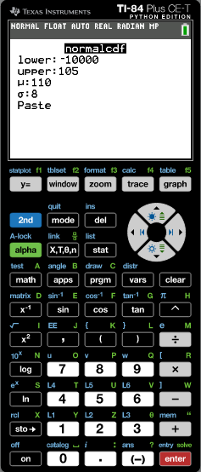
Example 2
The weights of pears are normally distributed with a mean of 110g and a standard deviation of 8g.
Find the percentage of pears that weigh between 100g and 130g.
It is known that 8% of the pears weigh more than m g. Find the value of m.
88.8%
c) 250 pears are weighed. Calculate the expected number of pears that weigh less than 105g.
121g
Sketch a diagram. μ = 110g σ = 8g
μ
110
μ – σ
102
μ + σ
118
μ - 2σ
94
μ + 2σ
126
μ - 3σ
86
μ + 3σ
134
Type the information from the problem:
Lower: -10000
Upper: 105
μ: 110
σ: 8

Slide 22
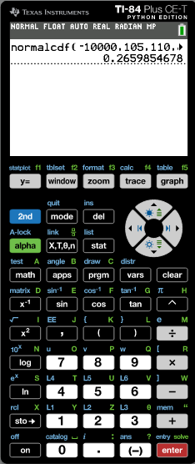
Example 2
The weights of pears are normally distributed with a mean of 110g and a standard deviation of 8g.
Find the percentage of pears that weigh between 100g and 130g.
It is known that 8% of the pears weigh more than m g. Find the value of m.
88.8%
c) 250 pears are weighed. Calculate the expected number of pears that weigh less than 105g.
121g
Sketch a diagram. μ = 110g σ = 8g
μ
110
μ – σ
102
μ + σ
118
μ - 2σ
94
μ + 2σ
126
μ - 3σ
86
μ + 3σ
134
The solution on the calculator is 0.2659854678
So the percentage of pears that weigh between 100g and 130g is 26.6%.
250 x 0.266 = 66.5, so the expected number of pears that weigh less than 105g is 66 or 67.

Slide 23
Thank you for using resources from
For more resources visit our website
https://www.mathssupport.org
If you have a special request, drop us an email
info@mathssupport.org

