Slide 1
Calculations with numbers expressed in standard form
LO: Perform calculations with numbers expressed in standard form

Slide 2
Ordering numbers in standard form
Write these numbers in order from smallest to largest:
5.3 × 10⁻⁴, 6.8 × 10⁻⁵, 4.7 × 10⁻³, 1.5 × 10⁻⁴.
To order numbers that are written in standard form start by comparing the powers of 10.
Remember, 10⁻⁵ is smaller than 10⁻⁴. That means that 6.8 × 10⁻⁵ is the smallest number in the list.
When two or more numbers have the same power of ten we can compare the number parts. 5.3 × 10⁻⁴ is larger than
1.5 × 10⁻⁴ so the correct order is:
6.8 × 10⁻⁵, 1.5 × 10⁻⁴, 5.3 × 10⁻⁴, 4.7 × 10⁻³

Slide 3
Calculations involving standard form
What is 2 × 10⁵ multiplied by 7.2 × 10³ ?
To multiply these numbers together we can multiply the number parts together and then the powers of ten together.
2 × 10⁵ × 7.2 × 10³ =
(2 × 7.2) × (10⁵ × 10³)
= 14.4
× 10⁸
This answer is not in standard form and must be converted!
14.4 × 10⁸ =
1.44 × 10 × 10⁸
= 1.44 × 10⁹

Slide 4
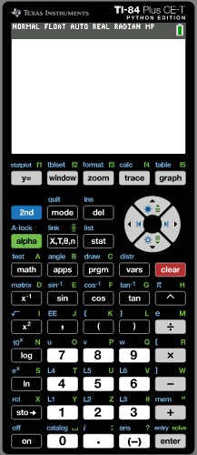




Calculations involving standard form
Using GDC
What is 2 × 10⁵ multiplied by 7.2 × 10³ ?
Turn on the GDC.
Click on

Slide 5
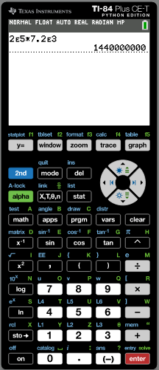
Calculations involving standard form
Using GDC
What is 2 × 10⁵ multiplied by 7.2 × 10³ ?
Turn on the GDC.
Click on
The answer is
1440000000
This answer is not in standard form so, it must be converted
1440000000
= 1.44 × 10⁹

Slide 6
Calculations involving standard form
What is 1.2 × 10⁻⁶ divided by 4.8 × 10⁷ ?
To divide these numbers we can divide the number parts and then divide the powers of ten.
(1.2 × 10⁻⁶) ÷ (4.8 × 10⁷) =
(1.2 ÷ 4.8) × (10⁻⁶ ÷ 10⁷)
= 0.25
× 10⁻¹³
This answer is not in standard form and must be converted.
0.25 × 10⁻¹³ =
2.5 × 10⁻¹ × 10⁻¹³
= 2.5 × 10⁻¹⁴

Slide 7
Calculations involving standard form
Using GDC
What is 1.2 × 10⁻⁶ divided by 4.8 × 10⁷ ?
Turn on the GDC.
Click on

Slide 8
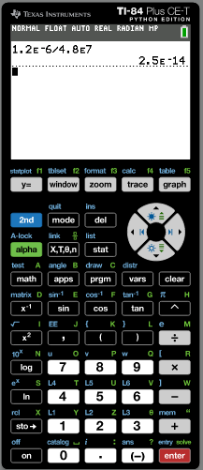
Calculations involving standard form
Using GDC
What is 1.2 × 10⁻⁶ divided by 4.8 × 10⁷ ?
Turn on the GDC.
Click on
= 2.5 × 10⁻¹⁴

Slide 9
Calculations involving standard form
How long would it take a spaceship travelling at an average speed of 2.6 × 10³ km/h to reach Mars 8.32 × 10⁷ km away?
distance
distance
Rearrange
speed =
to give
time =
time
speed
8.32 × 10⁷
Time to reach Mars =
2.6 × 10³
= 3.2 × 10⁴ hours
This is 8.32 ÷ 2.6
This is
10⁷ ÷ 10³

Slide 10
Calculations involving standard form
Use your calculator to work out how long 3.2 × 10⁴ hours is in years.
You can enter 3.2 × 10⁴ into your calculator using the keys:
Divide by 24 to give the equivalent number of days.
Divide by 365 to give the equivalent number of years.
= 3.652968037
3.2 × 10⁴ hours is about 3.65 years.

Slide 11
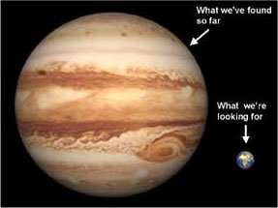

Calculations involving standard form
The mass of the Earth is approximately
6 000 000 000 000 000 000 000 000 kg. Write this number in standard form.
6.0 x 10²⁴
The mass of Jupiter is approximately
2 390 000 000 000 000 000 000 000 000 kg. Write this number in standard form.
2.39 x 10²⁷
How many times more massive is Jupiter than Earth?
$$\frac{2.39×{10}^{27}}{6.0×{10}^{24}}=$$
3.98 x 10²
Jupiter is 3.98 x 10² times the mass of the Earth
www.mathssupport.org

Slide 12
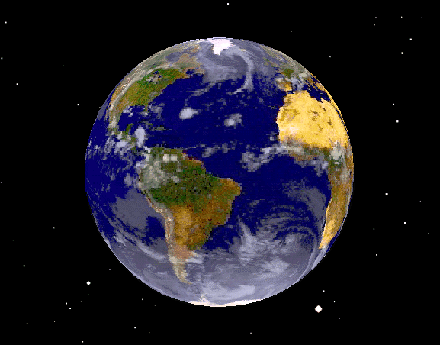
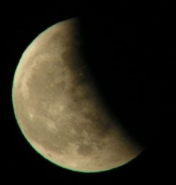



Calculations involving standard form
Taking the distance to the moon is 3.84 x 10⁵ km and the average speed of a spaceship as 8.0 x 10³ km/h, find the time taken for it to travel to the moon.
$$s=\frac{d}{t}$$
$$t=\frac{d}{s}$$
$$=\frac{3.84×{10}^{5}}{8.0×{10}^{3}}$$
⇒
= 48 hours
www.mathssupport.org

Slide 13
Calculations involving standard form
Two satellites travel distances of 5.8 x 10⁴ and 2.2 x 10⁵ km. Find the combined distance travelled.
5.8 x 10⁴ + 2.2 x 10⁵ = 2.78 x 10⁵ km.
www.mathssupport.org

Slide 14

Thank you for using resources from
For more resources visit our website
https://www.mathssupport.org
If you have a special request, drop us an email
info@mathssupport.org

