Slide 1
Properties of logarithms
LO: Know and use properties of logarithms to change between exponential and logarithmic forms.

Slide 2
Some important results
We are familiar with the exponential notation
Index, exponent or logarithm
2³
=
8
For example:
Base
Power
We read: “the third power of two is”
It means that we take two as a factor three times
2 × 2 × 2 =
8
and the power is
We can write the same using a different notation
log₂ 8 = 3
logarithm
Base
Power or Argument
This is called logarithmic notation
We read: “the logarithm of 8, to base 2 is 3”

Slide 3
Some important results
a^{x} = b
If
This can be written in logarithmic form as:
log_{a} b = x
x is the logarithm of b, to base a.:
Being able to change between these two forms allows you to simplify log statements
Examples:
Write the equivalent logarithmic statement for 3⁴ = 81
log₃ 81 = 4
Write the equivalent exponential statement for log₂ 128 = 7
2⁷ = 128

Slide 4
Some important results
Some properties of logarithms that is important to remember when manipulating logarithms.
Write the equivalent logarithmic statement for 3¹
= 3
log₃ 3 = 1
Write the equivalent logarithmic statement for 8¹
= 8
log₈ 8 = 1
In general
a¹ = a
This can be written in logarithmic form as:
log_{a} a = 1

Slide 5
Some important results
Some properties of logarithms that is important to remember when manipulating logarithms.
Write the equivalent logarithmic statement for 3⁰
= 1
log₃ 1 = 0
Write the equivalent logarithmic statement for 8⁰
= 1
log₈ 1 = 0
In general
a⁰ = 1
This can be written in logarithmic form as:
log_{a} 1 = 0

Slide 6
Some important results
Some properties of logarithms that is important to remember when manipulating logarithms.
Write the equivalent exponential statement for log₃ (-27)
= x
3^{x} = -27
Can you find an exponent that satisfies this equation?
This equation has no solution
log_{a} b is undefined for any base a if b is negative

Slide 7
Some important results
Some properties of logarithms that is important to remember when manipulating logarithms.
Write the equivalent exponential statement for log₃ 0
= x
3^{x} = 0
Can you find an exponent that satisfies this equation?
This equation has no solution
log_{a} 0 is undefined

Slide 8
Some important results
Some properties of logarithms that is important to remember when manipulating logarithms.
= x
Write the equivalent exponential statement for log₃ 3⁵
3^{x} = 3⁵
We have an exponential equation with the same base
The exponents must be equal
log_{a} (a^{n}) = n

Slide 9
Logarithms in base 10 and Natural logarithm

Slide 10
Logarithms in base 10
10 ^{x} = a
If
This can be written in logarithmic form as:
log₁₀ a = x
For logarithms base 10 is not necessary to write the base
This expression can be written simply as
log a = x
Examples:
log₁₀ 100 = 2
Can be written as
log 100 = 2

Slide 11
Logarithms in base 10
Our decimal number system is based on powers of ten.
We can write powers of ten using logarithmic notation.
10⁵ =
100 000
log 100 000 = 5
10⁴ =
10 000
log 10 000 = 4
10³ =
1 000
log 1000 = 3
10² =
100
log 100 = 2
10¹=
10
log 10 = 1
10⁰ =
1
log 1 = 0
10⁻¹ =
0.1
log 0.1 = -1
10⁻² =
0.01
log 0.01 = -2
10⁻³ =
0.001
log 0.001 = -3
What about other numbers? For example, what is log 125.
We know is a number between log 100 and log 1000.

Slide 12
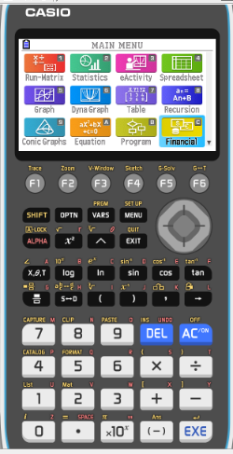
Using a GDC for Logarithms in base 10
We are going to use Graphing display calculator to find the logarithm base 10
CASIO

Slide 13
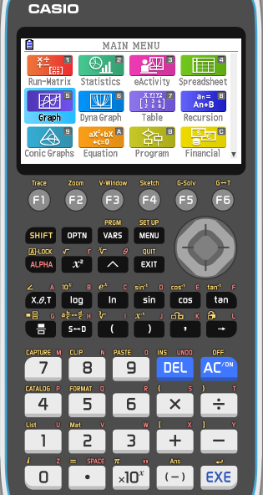
Logarithms in base 10
We use a calculator to find log 125.
Turn on
MENU
1

Slide 14
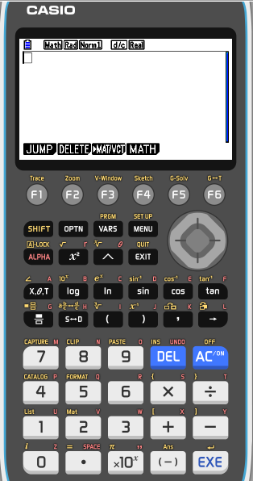
Logarithms in base 10
We use a calculator to find log 125.
Turn on
MENU
1
Type
Log
125
EXE

Slide 15
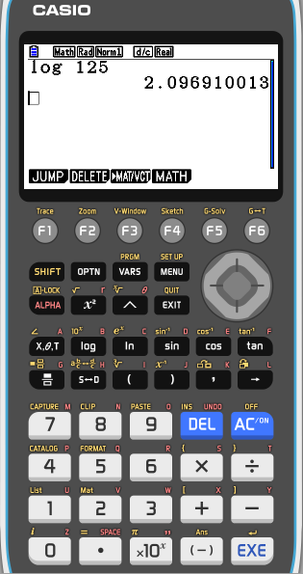
Logarithms in base 10
We use a calculator to find log 125.
Turn on
MENU
1
Type
Log
125
EXE

Slide 16
Natural logarithm

Slide 17
Natural Logarithms
The natural logarithm of a number is its logarithm to the base of the mathematical constant e
e is an irrational and transcendental number approximately equal to 2.718281828459.
The natural logarithm of x is generally written as ln x, log_{e} x
We use ln x to represent log_{e} x, and call ln x the natural logarithm of x
ln x = y
e^{y} = x
Notice that:
ln 1 =
ln e⁰ =
0
ln e =
ln e¹ =
1
ln e² =
2

Slide 18
Natural Logarithms
We are going to use Graphing display calculator to find ln 125.
Turn on
MENU
1

Slide 19
Natural Logarithms
We use a calculator to find ln 125.
Turn on
MENU
1
Type
ln
125
EXE

Slide 20
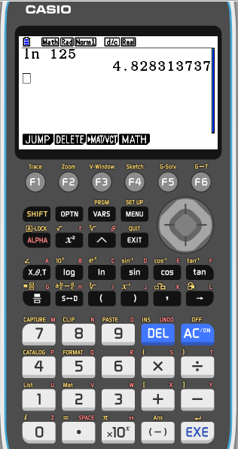
Natural Logarithms
We use a calculator to find ln 125.
Turn on
MENU
1
Type
ln
125
EXE

Slide 21
Thank you for using resources from
For more resources visit our website
https://www.mathssupport.org
If you have a special request, drop us an email
info@mathssupport.org

