Slide 1
Angles of elevation and depression
LO: To use trigonometric ratios to solve problems involving angles of elevation and angles of depression.

Slide 2
Problem solving using trigonometry
When problems are solved using trigonometry we follow these steps:
Step 1 : Read the question carefully.
Step 2 : Draw a diagram, not necessarily to scale, with the given information clearly marked.
Step 3 : If necessary, label the vertices of triangles in the figure.
Step 4 : State clearly any assumptions you make which enable you to use right angles triangles or properties of other geometric figures .
Step 5 : Choose an appropriate trigonometric ratio and use it to generate an equation connecting the quantities.
Step 6 : Solve the equations(s) to find the unknown.
Step 7 : Answer the question in words.

Slide 3
Problem solving
A 5 m ladder is resting against a wall. It makes an angle of 70° with the ground.
What is the distance between the base of the ladder and the wall?
First draw a sketch
Now label the sides
We are given the hypotenuse and we want to find the length of the side adjacent to the angle, so we use:
5 m
o
h
adjacent
cos θ =
hypotenuse
70°
x
a
x
cos 70° =
5
x = 5 × cos 70°
= 1.71 m (to 2 d.p.)

Slide 4
Problem solving
The angle between a tangent from point P to a circle and the line from P to the centre of the circle is 27º.
Determine the length of the line from P to the centre of the circle if the radius is 3 cm.
First draw a sketch
Now label the sides
We are given the opposite and we want to find the length of the hypotenuse, so we use:
opposite
a
sin θ =
o
27º
hypotenuse
3 cm
C
h
x cm
P
3
sin 27° =
x
3
x =
sin 27°
x =
6.61 m (to 2 d.p.)

Slide 5
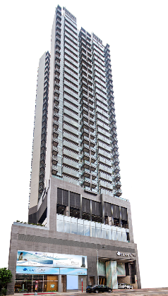
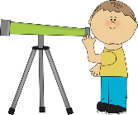
Angles of elevation
In this lesson we will se how to apply the trigonometric ratios to solve problems in real-life situations
Angle of elevation is the angle made between the horizon and the observer's line of sight to an object when the observer is looking upwards.
Angle of elevation
Horizon

Slide 6
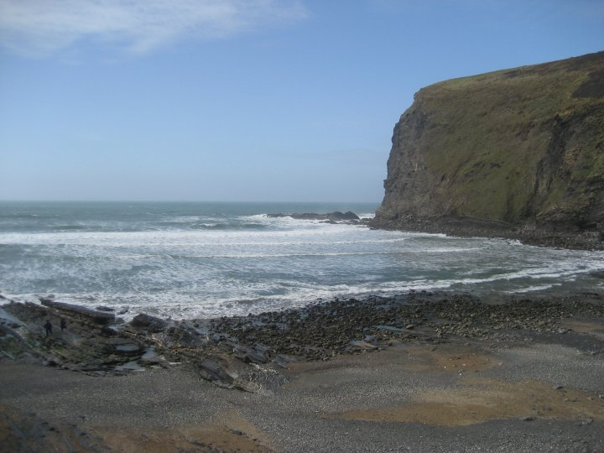
Angles of depression
In this lesson we will se how to apply the trigonometric ratios to solve problems in real-life situations
Angle of depression is the angle made between the horizon and the observer’s line of sight to an object when the observer is looking downwards.
Horizon
Angle of depression

Slide 7
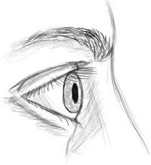
Angles of elevation
Example 1
An observer stands 100 m from the base of a building. The Angle of elevation of the top of the building is 65º. How tall is the building, to the nearest metre?
First draw a sketch
Now label the sides
We are given the adjacent side and we want to find the length of the side opposite to the angle, so we use:
opposite
tan 65º =
o
adjacent
h
x
tan 65º =
$$\frac{x}{100}$$
65º
a
100 m
x = 100(tan 65º )
x = 214.45
To the nearest metre it is 214 m

Slide 8
Angles of depression
Example 2
From a vertical cliff 80m above sea level, a boat is observed at an angle of depression of 6º. How far out the sea is the boat?
First draw a sketch
Now label the sides
We are given the opposite side and we want to find the length of the side adjacent to the angle, so we use:
a
x
opposite
6º
tan 6º =
80 m
adjacent
o
h
$$\frac{80}{x}$$
tan 6º =
$$\frac{80}{\tan{6°}}$$
x =
x = 761.15
To the nearest metre it is 761 m

Slide 9
Angles of depression
Example 3
From the top of a 150 m high-rise building, two cars on the same road below the building are seen at an angle of depression of 45º and 60º on each side of the tower. Find the distance between the two cars, correct to the nearest metre.
First draw a sketch
Working the triangle at the left
Now label the sides
We are given the opposite side and we want to find the length of the side adjacent to the 45º angle, so we use:
a
opposite
tan 45º =
adjacent
45º
60º
tan 45º =
$$\frac{150}{x}$$
o
150 m
h
x = $\frac{150}{\tan{45°}}$
x
+
y
x = 150
The distance from the red car to the tower is 150 m

Slide 10
Angles of depression
Example 3
From the top of a 150 m high-rise building, two cars on the same road below the building are seen at an angle of depression of 45º and 60º on each side of the tower. Find the distance between the two cars, correct to the nearest metre.
We have the sketch
Working the triangle at the right
Now label the sides
We are given the opposite side and we want to find the length of the side adjacent to the 60º angle, so we use:
a
opposite
tan 60º =
adjacent
45º
60º
tan 60º =
$$\frac{150}{x}$$
150 m
o
h
x = $\frac{150}{\tan{60°}}$
150
+
y
x ≈ 86.6
The distance from the blue car to the tower (y) is 87 m
To the nearest metre

Slide 11
Angles of depression
Example 3
From the top of a 150 m high-rise building, two cars on the same road below the building are seen at an angle of depression of 45º and 60º on each side of the tower. Find the distance between the two cars, correct to the nearest metre.
The distance between the two cars, correct to the nearest metre is the sum of the two distances
Distance =
x + y
45º
60º
Distance =
150 + 87
150 m
Distance = 237
150
+
87
The distance from the blue car to the red car is 237 m
To the nearest metre

Slide 12
Thank you for using resources from
For more resources visit our website
https://www.mathssupport.org
If you have a special request, drop us an email
info@mathssupport.org
Get 20% off in your next purchase from our website, just use this code when checkout: MSUPPORT_20

