Slide 1
Trigonometric ratios
LO: Use the trigonometric ratios to calculate sides or angles in right-angled triangles.

Slide 2
Right-angled triangles
A right-angled triangle contains a right angle.
The right-angled triangle has vertices at the points A, B and C.
The angles at these vertices are called $\hat{A}, \hat{B},$and $\hat{C}$ respectively.
A
The side AB, is the longest side, is opposite the right angle, is called the hypotenuse.
c
b
C
a
B
As convention the side BC, opposite to the angle $\hat{A}$ is labelled a.
the side AC, opposite to the angle $\hat{B}$ is labelled b.
the side AB, opposite to the angle $\hat{C}$ is labelled c.

Slide 3
The opposite and adjacent sides
The two shorter sides of a right-angled triangle, generally called legs, are named with respect to one of the acute angles.
The side opposite the marked angle is called the opposite side.
O
P
P
O
S
I
T
E
H
Y
P
O
T
E
N
U
S
E
θ
The side between the marked angle and the right angle is called the adjacent side.
A D J A C E N T
If we mark this angle

Slide 4
The opposite and adjacent sides
The two shorter sides of a right-angled triangle, generally called legs, are named with respect to one of the acute angles.
If we mark this angle
The side between the marked angle and the right angle is called the adjacent side.
A
D
J
A
C
E
N
T
H
Y
P
θ
O
T
E
N
U
S
E
O P P O S I T E
The side opposite the marked angle is called the opposite side.

Slide 5
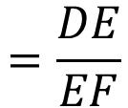
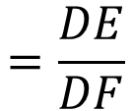
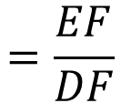
Trigonometric ratios
Look at this two right-angled triangles.
ΔABC and ΔDEF each have angles measuring 63º, 90º and 27º
ΔDEF is larger than ΔABC.
D
A
63º
63º
27º
27º
B
C
E
F
Triangles with the same three angles are called similar triangles, and their corresponding sides are in the same proportions.
For ΔABC and ΔDEF:
$$\frac{AB}{AC}$$
$$=\frac{DE}{DF}$$
and
$$\frac{AB}{BC}$$
$$=\frac{DE}{EF}$$
and
$$\frac{BC}{AC}$$
$$=\frac{EF}{DF}$$

Slide 6
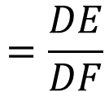
Trigonometric ratios
If we consider any right-angled triangle.
$$\frac{AB}{AC}$$
$$=\frac{DE}{DF}$$
opposite
=
= sin θ
hypotenuse
D
O
P
P
O
S
I
T
E
H
A
Y
P
O
P
P
O
S
I
T
E
H
Y
O
P
T
E
O
T
N
E
N
U
U
S
E
S
E
θ
θ
B
C
E
F
And we mark this angle
the length of the opposite side
The ratio of
is the sine ratio.
the length of the hypotenuse

Slide 7
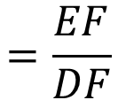
Trigonometric ratios
If we consider any right-angled triangle.
$$\frac{BC}{AC}$$
$$=\frac{EF}{DF}$$
adjacent
=
= cos θ
hypotenuse
D
A
H
Y
H
P
O
Y
P
T
O
T
E
N
E
N
U
U
S
E
S
E
θ
θ
B
C
A D J A C E N T
E
F
A D J A C E N T
And we mark this angle
the length of the adjacent side
The ratio of
is the cosine ratio.
the length of the hypotenuse

Slide 8
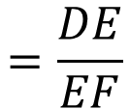
Trigonometric ratios
If we consider any right-angled triangle.
$$\frac{AB}{BC}$$
$$=\frac{DE}{EF}$$
opposite
=
= tan θ
adjacent
D
A
O
P
P
O
S
I
T
E
O
P
P
O
S
I
T
E
θ
θ
B
C
A D J A C E N T
E
F
A D J A C E N T
And we mark this angle
the length of the opposite side
The ratio of
is the tangent ratio.
the length of the adjacent side

Slide 9
The three trigonometric ratios
Opposite
S O H
Sin θ =
H
Hypotenuse
O
P
P
O
S
I
T
E
Y
P
O
T
Adjacent
E
Cos θ =
C A H
N
Hypotenuse
U
S
E
θ
Opposite
T O A
Tan θ =
Adjacent
A D J A C E N T
Remember:
S O H
C A H
T O A
You can use trigonometric ratios to find unknown side lengths and angles in right-angled triangles.

Slide 10
Relation between sine, cosine and tangent
Finding the ratio between sine and cosine
In triangle ABC
$$\frac{a}{c}$$
sin θ
=
sin θ
cos θ
cos θ
$$\frac{b}{c}$$
A
=
$$\frac{a}{c}$$
θ
c
tan θ
=
$$\frac{a}{b}$$
=
b
$$\frac{b}{c}$$
C
a
B
=
$$\frac{a}{b}$$
sin θ
tan θ
=
cos θ

Slide 11
Finding side lengths
S O H
C A H
T O A
If we are given one side and one acute angle in a right-angled triangle we can use one of the three trigonometric ratios to find the lengths of other sides. For example,
Find x to 2 decimal places.
First label the sides
We are given the hypotenuse and we want to find the length of the side opposite the angle, so we use:
opposite
sin θ =
hypotenuse
h
o
x
12 cm
x
sin 54° =
12
x = 12 (sin 54°)
54°
= 9.71 cm
a

Slide 12
Finding side lengths
S O H
C A H
T O A
If we are given one side and one acute angle in a right-angled triangle we can use one of the three trigonometric ratios to find the lengths of other sides. For example,
Find x to 2 decimal places.
First label the sides
We are given the opposite side and we want to find the length of the hypotenuse, so we use:
opposite
sin θ =
25°
hypotenuse
h
a
14
x
sin 25° =
x
14
x =
sin 25°
o
14 cm
= 33.13 cm

Slide 13
Finding side lengths
S O H
C A H
T O A
If we are given one side and one acute angle in a right-angled triangle we can use one of the three trigonometric ratios to find the lengths of other sides. For example,
Find x to 2 decimal places.
First label the sides
We are given the side adjacent to the angle and we want to find the length of the hypotenuse, so we use:
adjacent
cos θ =
hypotenuse
h
o
3
x
cos 65° =
x
3
x =
65°
cos 65°
a
3 m
= 7.10 m

Slide 14
Finding side lengths
S O H
C A H
T O A
If we are given one side and one acute angle in a right-angled triangle we can use one of the three trigonometric ratios to find the lengths of other sides. For example,
Find x to 2 decimal places.
First label the sides
We are given the side hypotenuse and we want to find the length of the adjacent to the angle , so we use:
adjacent
cos θ =
42°
hypotenuse
h
x
a
cos 42° =
9 cm
x
9
x = 9 (cos 42°)
= 6.69 cm
o

Slide 15
Finding side lengths
S O H
C A H
T O A
If we are given one side and one acute angle in a right-angled triangle we can use one of the three trigonometric ratios to find the lengths of other sides. For example,
Find x to 2 decimal places.
First label the sides
We are given the adjacent side and we want to find the length of the side opposite the angle, so we use:
opposite
tan θ =
adjacent
h
o
x
x
tan 60° =
8.7
x = 8.7 × tan 60°
60°
a
8.7 cm
= 15.07 cm

Slide 16
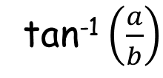
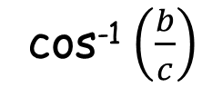
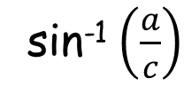
Finding angles
In the right-angled triangle ABC, if we wish to find the size of an acute angle we need to know the length of two sides
A
If
sin θ
=
$$\frac{a}{c}$$
then
θ
=
sin⁻¹ $\left(\frac{a}{c}\right)$
θ
c
b
Which reads the angle with a sine $\frac{a}{c}$
C
a
B
$$\frac{b}{c}$$
cos⁻¹ $\left(\frac{b}{c}\right)$
If
cos θ
=
then
θ
=
Which reads the angle with a cosine $\frac{b}{c}$
If
tan θ
=
$$\frac{a}{b}$$
then
θ
=
tan⁻¹ $\left(\frac{a}{b}\right)$
Which reads the angle with a tangent $\frac{b}{c}$

Slide 17
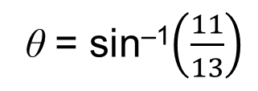
Finding angles
o
11 cm
Find θ to 2 decimal places.
h
13 cm
θ
First label the given sides
We are given the lengths of the sides opposite and hypotenuse, so we use:
opposite
sin θ =
hypotenuse
11
sin θ =
13
θ = sin^{–1}$\left(\frac{11}{13}\right)$
θ = 57.80° (to 2 d.p.)

Slide 18
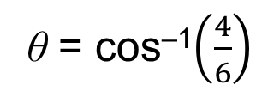
Finding angles
a
4 cm
Find θ to 2 decimal places.
θ
h
6 cm
First label the given sides
We are given the lengths of the sides adjacent and hypotenuse, so we use:
adjacent
cos θ =
hypotenuse
4
cos θ =
6
θ = cos^{–1}$\left(\frac{4}{6}\right)$
θ = 48.19° (to 2 d.p.)

Slide 19
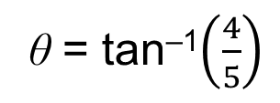
Finding angles
o
4 cm
a
5 cm
Find θ to 2 decimal places.
θ
First label the given sides
We are given the lengths of the sides opposite and adjacent to the angle, so we use:
opposite
tan θ =
adjacent
4
tan θ =
5
θ = tan^{–1}$\left(\frac{4}{5}\right)$
θ = 38.66° (to 2 d.p.)

Slide 20
Thank you for using resources from
For more resources visit our website
https://www.mathssupport.org
If you have a special request, drop us an email
info@mathssupport.org
Get 20% off in your next purchase from our website, just use this code when checkout: MSUPPORT_20

