Slide 1
Exponential growth and decay models
LO: Use exponential functions to model real-life situations.

Slide 2
Exponential function
An exponential function has a number, called the base, raised to a power,
the independent variable (x) is the index or power.
In general, the form of an exponential function is:
f(x) = ka^{x} + c where a > 0, a ≠ 1 and k ≠ 0
Let’s look at the shape of some exponential functions
y = 2^{x}
What is the y-intercept?
(0, 1)
y
Is the graph increasing or decreasing?
Increasing.
It is called exponential Growth
What is the value of k?
1
of a?
2
of c?
0
What is the line that the graph get closer to, but never touch?
x
The x-axis.
It is called an asymptote
Its equation is y = 0

Slide 3
Exponential function
An exponential function has a number, called the base, raised to a power,
the independent variable (x) is the index or power.
In general, the form of an exponential function is:
f(x) = ka^{x} + c where a > 0, a ≠ 1 and k ≠ 0
Let’s look at the shape of some exponential functions
y = 3^{x}
What is the y-intercept?
(0, 1)
y
Is the graph increasing or decreasing?
Increasing.
It is called exponential Growth
What is the value of k?
1
of a?
3
of c?
0
What is the line that the graph get closer to, but never touch?
x
The x-axis.
It is called an asymptote
Its equation is y = 0

Slide 4
Exponential function
An exponential function has a number, called the base, raised to a power,
the independent variable (x) is the index or power.
In general, the form of an exponential function is:
f(x) = ka^{x} + c where a > 0, a ≠ 1 and k ≠ 0
Let’s look at the shape of some exponential functions
y = 3(2)^{x}
What is the y-intercept?
(0, 3)
y
Is the graph increasing or decreasing?
Increasing.
It is called exponential Growth
What is the value of k?
3
of a?
2
of c?
0
What is the line that the graph get closer to, but never touch?
x
The x-axis.
It is called an asymptote
Its equation is y = 0

Slide 5
Exponential function
An exponential function has a number, called the base, raised to a power,
the independent variable (x) is the index or power.
In general, the form of an exponential function is:
f(x) = ka^{x} + c where a > 0, a ≠ 1 and k ≠ 0
Let’s look at the shape of some exponential functions
y = 3(2)^{x} - 1
What is the y-intercept?
(0, 3)
y
Is the graph increasing or decreasing?
Increasing.
It is called exponential Growth
What is the value of k?
3
of a?
2
of c?
-1
What is the line that the graph get closer to, but never touch?
x
The line with equation y = –1
It is called an asymptote

Slide 6
Exponential function
An exponential function has a number, called the base, raised to a power,
the independent variable (x) is the index or power.
In general, the form of an exponential function is:
f(x) = ka^{x} + c where a > 0, a ≠ 1 and k ≠ 0
Let’s look at the shape of some exponential functions
y = ${\left(\frac{1}{2}\right)}^{x}$
What is the y-intercept?
(0, 1)
y
Is the graph increasing or decreasing?
Decreasing.
It is called exponential Decay
What is the value of k?
1
of a?
$$\frac{1}{2}$$
of c?
0
What is the line that the graph get closer to, but never touch?
x
The x-axis.
It is called an asymptote
Its equation is y = 0

Slide 7
Exponential function
An exponential function has a number, called the base, raised to a power,
the independent variable (x) is the index or power.
In general, the form of an exponential function is:
f(x) = ka^{x} + c where a > 0, a ≠ 1 and k ≠ 0
Let’s look at the shape of some exponential functions
y = ${\left(\frac{1}{2}\right)}^{x}$+ 3
What is the y-intercept?
(0, 4)
y
Is the graph increasing or decreasing?
Decreasing.
It is called exponential Decay
What is the value of k?
1
of a?
$$\frac{1}{2}$$
of c?
3
What is the line that the graph get closer to, but never touch?
x
The line with equation y = 3
It is called an asymptote

Slide 8
Exponential function
Sumarising.
In general, the form of an exponential function is:
f(x) = ka^{x} + c where a > 0, a ≠ 1 and k ≠ 0
The parameter k is the vertical stretch factor
If a > 1 the graph is increasing so, it is exponential growth
If 0 < a < 1 the graph is decreasing so, it is exponential decay
The parameter c is the vertical translation of the graph.
The equation of the horizontal asymptote is y = c
The y-intercept is the point (0, k + c)

Slide 9
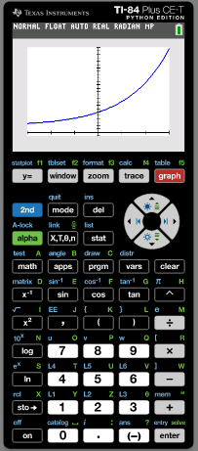
Sketching the graph of an exponential function
You need to be careful when copying the graph from your GDC onto paper.
Sketch the graph of
f(x) = 4(25)^{0.18x} + 2
˗3 ≤ x ≤ 3
Draw your axes and label them
y
25
(3, 24.75)
Make sure that any x- and y-intercepts are in the correct place.
Determine the position of any asymptote.
(˗3, 2.70)
(0, 6)
y = 2
x
˗3
0
3
Plot the starting and ending points based on the given domain

Slide 10
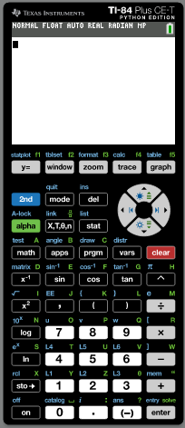
Modelling with a exponential function
Exponential functions can be used to model real world data.
The data in the following table list the population of Benin from 1980 through 2019. (Source: https://data.worldbank.org/)
Year | Population
1980 | 3 717 165
1985 | 4 278 501
1990 | 4 978 496
1995 | 5 905 558
2000 | 6 865 951
2005 | 7 982 225
2010 | 9 199 259
2015 | 10 575 952
2019 | 11 801 151
Find an exponential function that models the data of the form y = ab^{x}
Turn on the calculator.
Click STAT (Statistics)

Slide 11
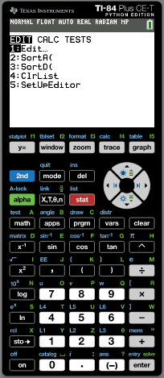
Modelling with a exponential function
Exponential functions can be used to model real world data.
The data in the following table list the population of Benin from 1980 through 2019. (Source: https://data.worldbank.org/)
Year | Population
1980 | 3 717 165
1985 | 4 278 501
1990 | 4 978 496
1995 | 5 905 558
2000 | 6 865 951
2005 | 7 982 225
2010 | 9 199 259
2015 | 10 575 952
2019 | 11 801 151
Find an exponential function that models the data of the form y = ab^{x}
Turn on the calculator.
Click STAT (Statistics)
Press 1 (Edit)

Slide 12
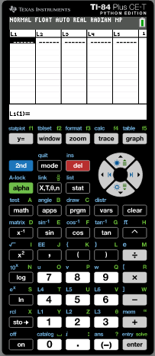
Modelling with a exponential function
Exponential functions can be used to model real world data.
The data in the following table list the population of Benin from 1980 through 2019. (Source: https://data.worldbank.org/)
Year | Population
1980 | 3 717 165
1985 | 4 278 501
1990 | 4 978 496
1995 | 5 905 558
2000 | 6 865 951
2005 | 7 982 225
2010 | 9 199 259
2015 | 10 575 952
2019 | 11 801 151
Find an exponential function that models the data of the form y = ab^{x}
(80)
(85)
Turn on the calculator.
(90)
Click STAT (Statistics)
Press 1 (Edit)
(95)
Clear all lists in the GDC
(100)
Type the data for Year in List 1 and Population in List 2
(105)
(110)
To make it simpler we will change the year numbers
(115)
(119)

Slide 13
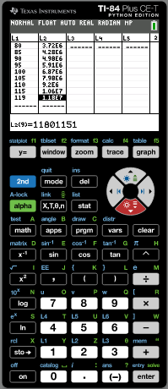
Modelling with a exponential function
Exponential functions can be used to model real world data.
The data in the following table list the population of Benin from 1980 through 2019. (Source: https://data.worldbank.org/)
Year | Population
1980 | 3 717 165
1985 | 4 278 501
1990 | 4 978 496
1995 | 5 905 558
2000 | 6 865 951
2005 | 7 982 225
2010 | 9 199 259
2015 | 10 575 952
2019 | 11 801 151
Find an exponential function that models the data of the form y = ab^{x}
(80)
(85)
Turn on the calculator.
(90)
Click STAT (Statistics)
Press 1 (Edit)
(95)
Clear all lists in the GDC
(100)
Type the data for Year in List 1 and Population in List 2
(105)
(110)
Press 2nd
statplot
(115)
(119)

Slide 14
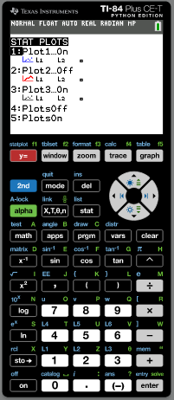
Modelling with a exponential function
Exponential functions can be used to model real world data.
The data in the following table list the population of Benin from 1980 through 2019. (Source: https://data.worldbank.org/)
Year | Population
1980 | 3 717 165
1985 | 4 278 501
1990 | 4 978 496
1995 | 5 905 558
2000 | 6 865 951
2005 | 7 982 225
2010 | 9 199 259
2015 | 10 575 952
2019 | 11 801 151
Find an exponential function that models the data of the form y = ab^{x}
(80)
(85)
Turn on the calculator.
(90)
Click STAT (Statistics)
Press 1 (Edit)
(95)
Clear all lists in the GDC
(100)
Type the data for Year in List 1 and Population in List 2
(105)
(110)
Press 2nd
statplot
Press 1
(115)
(119)

Slide 15
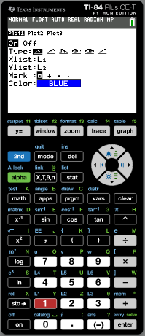
Modelling with a exponential function
Exponential functions can be used to model real world data.
The data in the following table list the population of Benin from 1980 through 2019. (Source: https://data.worldbank.org/)
Year | Population
1980 | 3 717 165
1985 | 4 278 501
1990 | 4 978 496
1995 | 5 905 558
2000 | 6 865 951
2005 | 7 982 225
2010 | 9 199 259
2015 | 10 575 952
2019 | 11 801 151
Find an exponential function that models the data of the form y = ab^{x}
(80)
(85)
Turn on the calculator.
(90)
Click STAT (Statistics)
Press 1 (Edit)
(95)
Clear all lists in the GDC
(100)
Type the data for Year in List 1 and Population in List 2
(105)
(110)
Press 2nd
statplot
Press 1
Plot1 ON
Xlist: L1
Ylist: L2
(115)
ZOOM
9ZoomStat
(119)

Slide 16
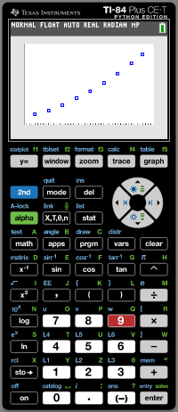
Modelling with a exponential function
Exponential functions can be used to model real world data.
The data in the following table list the population of Benin from 1980 through 2019. (Source: https://data.worldbank.org/)
Year | Population
1980 | 3 717 165
1985 | 4 278 501
1990 | 4 978 496
1995 | 5 905 558
2000 | 6 865 951
2005 | 7 982 225
2010 | 9 199 259
2015 | 10 575 952
2019 | 11 801 151
Find an exponential function that models the data of the form y = ab^{x}
(80)
(85)
Turn on the calculator.
(90)
Click STAT (Statistics)
Press 1 (Edit)
(95)
Clear all lists in the GDC
(100)
Type the data for Year in List 1 and Population in List 2
(105)
(110)
Press 2nd
statplot
Press 1
Plot1 ON
Xlist: L1
Ylist: L2
(115)
ZOOM
9ZoomStat
(119)
Press MODE.

Slide 17
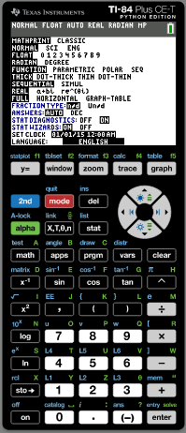
Modelling with a exponential function
Exponential functions can be used to model real world data.
The data in the following table list the population of Benin from 1980 through 2019. (Source: https://data.worldbank.org/)
Year | Population
1980 | 3 717 165
1985 | 4 278 501
1990 | 4 978 496
1995 | 5 905 558
2000 | 6 865 951
2005 | 7 982 225
2010 | 9 199 259
2015 | 10 575 952
2019 | 11 801 151
Find an exponential function that models the data of the form y = ab^{x}
(80)
(85)
Use the arrow to highlight STAT DIAGNOSIS
ON
(90)
Press STAT
(95)
(100)
(105)
(110)
(115)
(119)

Slide 18
Modelling with a exponential function
Exponential functions can be used to model real world data.
The data in the following table list the population of Benin from 1980 through 2019. (Source: https://data.worldbank.org/)
Year | Population
1980 | 3 717 165
1985 | 4 278 501
1990 | 4 978 496
1995 | 5 905 558
2000 | 6 865 951
2005 | 7 982 225
2010 | 9 199 259
2015 | 10 575 952
2019 | 11 801 151
Find an exponential function that models the data of the form y = ab^{x}
(80)
(85)
Use the arrow to highlight STAT DIAGNOSIS
ON
(90)
Press STAT

CALC
(95)
Scroll down
0:ExpReg
(100)
(105)
(110)
(115)
(119)

Slide 19
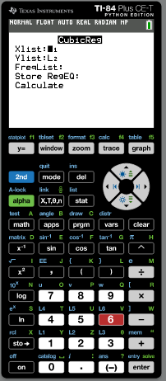
Modelling with a exponential function
Exponential functions can be used to model real world data.
The data in the following table list the population of Benin from 1980 through 2019. (Source: https://data.worldbank.org/)
Year | Population
1980 | 3 717 165
1985 | 4 278 501
1990 | 4 978 496
1995 | 5 905 558
2000 | 6 865 951
2005 | 7 982 225
2010 | 9 199 259
2015 | 10 575 952
2019 | 11 801 151
Find an exponential function that models the data of the form y = ab^{x}
(80)
(85)
Use the arrow to highlight STAT DIAGNOSIS
ON
(90)
Press STAT

CALC
(95)
Scroll down
0:ExpReg
(100)
Xlist: L1
Ylist: L2
(105)
Store RegEq
Press Vars
 Y-VARS
(110)
1-Function
1-Y1
(115)
Scroll down
Calculate
ENTER
(119)

Slide 20
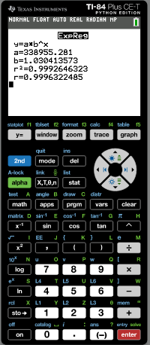
Modelling with a exponential function
Exponential functions can be used to model real world data.
The data in the following table list the population of Benin from 1980 through 2019. (Source: https://data.worldbank.org/)
Year | Population
1980 | 3 717 165
1985 | 4 278 501
1990 | 4 978 496
1995 | 5 905 558
2000 | 6 865 951
2005 | 7 982 225
2010 | 9 199 259
2015 | 10 575 952
2019 | 11 801 151
The general exponential function is:
(80)
y = ab^{x}
(85)
From the GDC we get
(90)
a = 338 955
b = 1.03
(95)
The data can be modelled with the function
(100)
y = 338 955(1.03)^{x}
(105)
The coefficient of determination R² reveals that 99.9% of the data fit the regression model
(110)
(115)
(119)
ZOOM
9ZoomStat
Drawing the graph

Slide 21
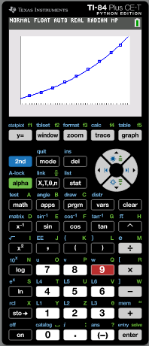
Modelling with a exponential function
Exponential functions can be used to model real world data.
The data in the following table list the population of Benin from 1980 through 2019. (Source: https://data.worldbank.org/)
Year | Population
1980 | 3 717 165
1985 | 4 278 501
1990 | 4 978 496
1995 | 5 905 558
2000 | 6 865 951
2005 | 7 982 225
2010 | 9 199 259
2015 | 10 575 952
2019 | 11 801 151
The general exponential function is:
(80)
y = ab^{x}
(85)
From the GDC we get
(90)
a = 338955
b = 1.03
(95)
The data can be modelled with the function
(100)
y = 338 955(1.03)^{x}
(105)
The coefficient of determination R² reveals that 99.9% of the data fit the regression model
(110)
(115)
(119)
ZOOM
9ZoomStat
Drawing the graph

Slide 22
Modelling with a exponential function
Exponential functions can be used to model real world data.
The data in the following table list the population of Benin from 1980 through 2019. (Source: https://data.worldbank.org/)
Year | Population
1980 | 3 717 165
1985 | 4 278 501
1990 | 4 978 496
1995 | 5 905 558
2000 | 6 865 951
2005 | 7 982 225
2010 | 9 199 259
2015 | 10 575 952
2019 | 11 801 151
Estimate the population of Benin in 1997.
(80)
(85)
CALC
2nd
TRACE
1:Value
Type
97
(90)
(95)
(100)
(105)
(110)
(115)
(119)

Slide 23
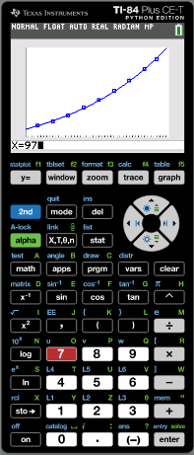
Modelling with a exponential function
Exponential functions can be used to model real world data.
The data in the following table list the population of Benin from 1980 through 2019. (Source: https://data.worldbank.org/)
Year | Population
1980 | 3 717 165
1985 | 4 278 501
1990 | 4 978 496
1995 | 5 905 558
2000 | 6 865 951
2005 | 7 982 225
2010 | 9 199 259
2015 | 10 575 952
2019 | 11 801 151
Estimate the population of Benin in 1997.
(80)
(85)
CALC
2nd
TRACE
1:Value
Type
97
(90)
ENTER
(95)
(100)
(105)
(110)
(115)
(119)

Slide 24
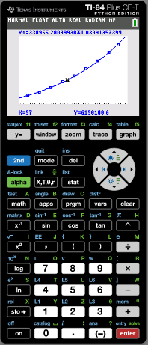
Modelling with a exponential function
Exponential functions can be used to model real world data.
The data in the following table list the population of Benin from 1980 through 2019. (Source: https://data.worldbank.org/)
Year | Population
1980 | 3 717 165
1985 | 4 278 501
1990 | 4 978 496
1995 | 5 905 558
2000 | 6 865 951
2005 | 7 982 225
2010 | 9 199 259
2015 | 10 575 952
2019 | 11 801 151
Estimate the population of Benin in 1997.
(80)
(85)
CALC
2nd
TRACE
1:Value
Type
97
(90)
ENTER
(95)
The population of Benin in 1997 was approximately
6 198 189.
(100)
(105)
(110)
(115)
(119)

Slide 25
Thank you for using resources from
For more resources visit our website
https://www.mathssupport.org
If you have a special request, drop us an email
info@mathssupport.org

