Slide 1
Geometric series
LO: Calculate the sum of the first n terms in a geometric series

Slide 2
The sum of a geometric series
A geometric series is the addition of successive terms of a geometric sequence.
For example:
1, 2, 4, 8, 16, … ,1024 is a sequence
while:
1 + 2 + 4 + 8 + 16 + … + 1024 is a series.
Sum of a finite geometric series
If u₁ is the first term, r is the common ratio and n is the number of terms in the series,
the third term will be
the antepenultimate term will be
the last term will be
the second term will be:
The sum of the first n terms can now be written as:
the penultimate term will be
S_{n} =
u₁
+
u₁ r
+
u₁ r²
+ …… +
u₁ r^{n-3}
+
u₁ r^{n-2}
+
u₁ r^{n-1}
u₁ r³
u₁ r^{n-3}
u₁ r^{n-1}
+
u₁ r^{n}
+ …… +
u₁ r^{n-2}
+
rS_{n} =
u₁ r
+
u₁ r²
+
+
S_{n} - rS_{n} =
u₁
- u₁ r^{n}
Multiplying by r
Move the lower row 1 place to the right
Subtracting the expressions gives
S_{n} - rS_{n} =
u₁
- u₁ r^{n}

Slide 3
The sum of a geometric series
S_{n} – rS_{n} =
u₁
– u₁ r^{n}
Removing the common factor
S_{n} (1 – r) =
u₁
(1 – r^{n})
Making S_{n} the subject
u₁
(1 – r^{n})
S_{n} =
(1 – r)
This formula gives a negative denominator if r > 1
We are going to look for a formula that give us a positive value, we can subtract the first row from the second one
S_{n} =
u₁
+
u₁ r
+
u₁ r²
+ …… +
u₁ r^{n-3}
+
u₁ r^{n-2}
+
u₁ r^{n-1}
u₁ r
u₁ r²
+ …… +
u₁ r^{n-3}
+
u₁ r^{n-2}
+
u₁ r^{n-1}
u₁ r^{n}
rS_{n} =
+
+
rS_{n}-S_{n} =
-u₁
+ u₁ r^{n}
S_{n} (r – 1) =
u₁
(r^{n} – 1)
rS_{n}–S_{n} =
u₁r^{n}
– u₁
u₁
(r^{n} – 1)
S_{n} =
(r – 1)

Slide 4
The sum of a geometric series
u₁
(r^{n} – 1)
u₁
(1 – r^{n})
S_{n} =
S_{n} =
(r – 1)
(1 – r)
Find the sum of the first 12 terms of the geometric series
2 + 6 + 18 + 54 + …
This series is geometric with u₁ = 2, r = 3and n = 12.
Because r > 1 we can use:
u₁
(r^{n} – 1)
S_{n} =
(r – 1)
2
(3¹² – 1)
S_{n} =
(3 – 1)
= 531 440

Slide 5
The sum of a geometric series
u₁
(r^{n} – 1)
u₁
(1 – r^{n})
S_{n} =
S_{n} =
(r – 1)
(1 – r)
Find the sum of the first 10 terms of the geometric series
4 - 2 + 1 + …
This series is geometric with u₁ = 4, r = -0.5 and n = 10.
Because r < 1 we can use:
u₁
(1 – r^{n})
S_{n} =
(1 – r)
4
(1 – (– 0.5)¹⁰)
S_{n} =
(1 – (– 0.5))
= 2.664

Slide 6
The sum of a geometric series
u₁
(r^{n} – 1)
u₁
(1 – r^{n})
S_{n} =
S_{n} =
(r – 1)
(1 – r)
Find a formula for the first n terms of
- 3 + 1 - …
1
3
1
The series is geometric with u₁ = 9 and r = -
3
Using this formula:
u₁
(1 – r^{n})
S_{n} =
(1 – r)
^{n}
1
^{n}
1
(1 – (– ) )
(1 – (– ) )
9
9
3
S_{n} =
3
=
(1 – (– ))
4
1
3
3
1
^{n}
27
(1 – (– ) )
S_{n} =
3
4

Slide 7
The sum of a geometric series
u₁
(r^{n} – 1)
u₁
(1 – r^{n})
S_{n} =
S_{n} =
(r – 1)
(1 – r)
A geometric sequence has first term 5 and common ratio 2. The sum of the first n terms of the sequence is 635.
Find n.
The sequence is geometric with u₁ = 5 and r = 2.
u₁
(r^{n} – 1)
S_{n} =
(r – 1)
5
(2^{n} – 1)
635 =
(2 – 1)
635 =
5
(2^{n} – 1)
We need to find n such that 5(2^{n} – 1) = 635

Slide 8
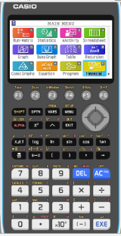
Using a GDC
A geometric sequence has first term 5 and common ratio 2. The sum of the first n terms of the sequence is 635.
Find n.
We need to find n such that 5(2^{n} – 1) = 635
We are going to use a Graphing display calculator to solve the problem
CASIO

Slide 9
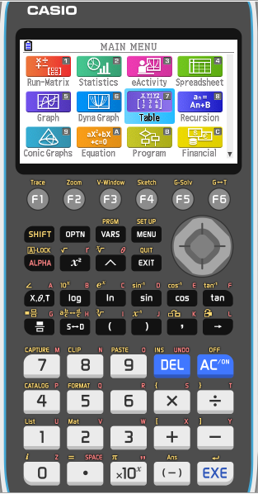
Using the GDC - Casio
We need to find n such that
5(2^{n} – 1) = 635
Select TABLE from the main MENU

Slide 10
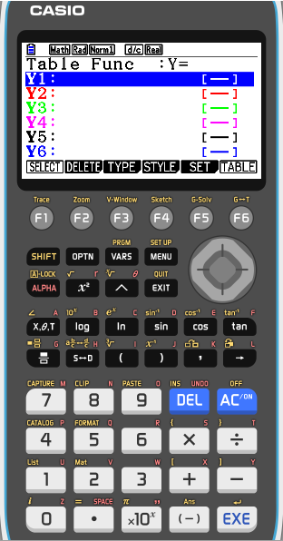
Using the GDC - Casio
We need to find n such that
5(2^{n} – 1) = 635
Select TABLE from the main MENU
Type in Y1 :
5
(
2
^
x

–
1
)

Slide 11
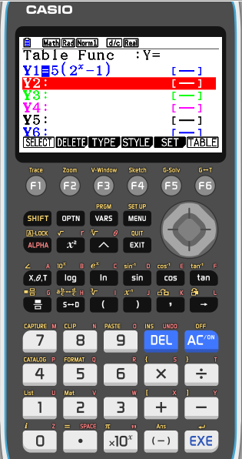
Using the GDC - Casio
We need to find n such that
5(2^{n} – 1) = 635
Select TABLE from the main MENU
Type in Y1 :
5
(
2
^
x

–
1
)
Press F5

Slide 12
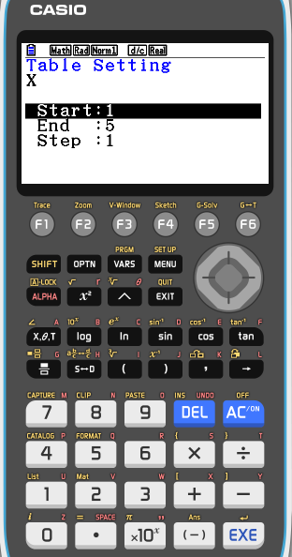
Using the GDC - Casio
We need to find n such that
5(2^{n} – 1) = 635
Select TABLE from the main MENU
Type in Y1 :
5
(
2
^
x

–
1
)
Press F5
State the starting number
1
EXE
State the ending number
20
EXE
State the step between numbers
1
EXE
Press F6

Slide 13
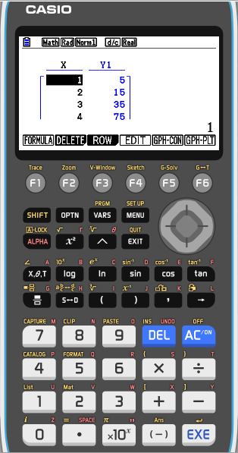
Using the GDC - Casio
We need to find n such that
5(2^{n} – 1) = 635
Select TABLE from the main MENU
Type in Y1 :
5
(
2
^
x

–
1
)
Press F5
State the starting number
1
EXE
State the ending number
20
EXE
State the step between numbers
1
Press F6
Scroll down until you find 635 for Y

Slide 14
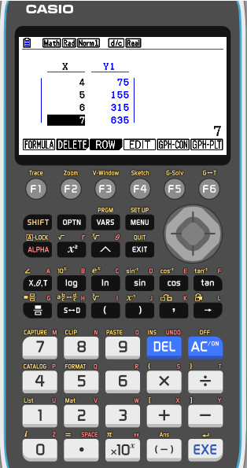
Using the GDC - Casio
We need to find n such that
5(2^{n} – 1) = 635
Select TABLE from the main MENU
Type in Y1 :
5
(
2
^
x

–
1
)
Press F5
State the starting number
1
EXE
State the ending number
20
EXE
State the step between numbers
1
Press F6
Scroll down until you find 635 for Y
So, S₇ = 635 ∴ n = 7

Slide 15
Thank you for using resources from
For more resources visit our website
https://www.mathssupport.org
If you have a special request, drop us an email
info@mathssupport.org

