Slide 1
The indefinite integral of the composition of functions with the linear function ax + b
LO: Find the indefinite integral of the composition of functions with the linear function ax + b.

Slide 2


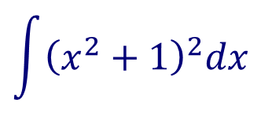
Indefinite integrals
Find the indefinite integral
$$\int{{\left(x^{2}+1\right)}^{2}dx}$$
$$=\int{(x^{4}+2x^{2}+1)dx}$$
Expand
$$=\frac{1}{5}x^{5}$$
$$+\frac{2}{3}x^{3}$$
Integrate each term
$$+ x$$
$$+ C$$

Slide 3
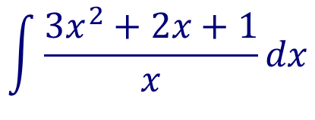

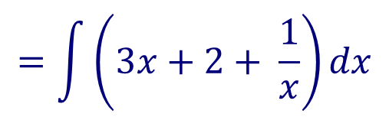
Indefinite integrals
Find the indefinite integral
$$\int{\frac{{3x}^{2}+2x+1}{x}dx}$$
$$=\int{\left(\frac{3x^{2}}{x}+\frac{2x}{x}+\frac{1}{x}\right)dx}$$
Separating terms
$$=\int{\left(3x+2+ \frac{1}{x}\right)dx}$$
Simplifying
Integrating each term
$$=\frac{3}{2}x^{2}$$
, x > 0
$$+ 2x$$
$$+\ln{x}$$
$$+ C$$

Slide 4
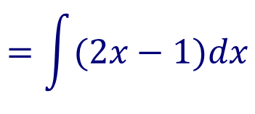
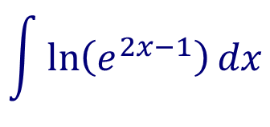
Indefinite integrals
Find the indefinite integral
$$\int{\ln\left(e^{2x−1}\right)dx}$$
$$=\int{(2x−1)dx}$$
$$=x^{2}$$
$$− x$$
$$+ C$$

Slide 5
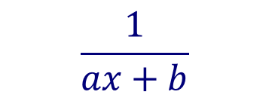


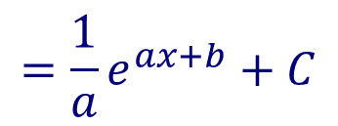


Indefinite integrals
Now we look at indefinite integrals of functions that are compositions with the linear function ax + b
$$\frac{1}{ax+b}$$
$${\left(ax+b\right)}^{n}$$
$$e^{ax+b}$$
$$\int{{\left(ax+b\right)}^{n}dx}$$
$$=\frac{1}{a}\left(\frac{1}{n+1}{\left(ax+b\right)}^{n+1}\right)+C$$
$$\int{e^{ax+b}dx}$$
$$=\frac{1}{a}e^{ax+b}+C$$
$$\int{\frac{1}{ax+b}dx}$$
$$=\frac{1}{a}\ln{(ax+b)}+C$$
, x > $−\frac{b}{a}$
$$=\frac{1}{a}\ln{|ax+b|}+C$$

Slide 6

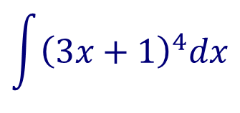
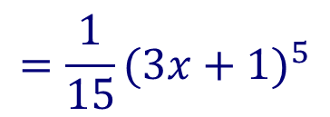
$$\int{{\left(ax+b\right)}^{n}dx}$$
$$=\frac{1}{a}\left(\frac{1}{n+1}{\left(ax+b\right)}^{n+1}\right)+C$$
Indefinite integrals
$$\int{{\left(3x+1\right)}^{4}dx}$$
Find the indefinite integral
$$a=3$$
$$b=1$$
$$n=4$$
$$=\frac{1}{3}\left(\frac{1}{4+1}{\left(3x+1\right)}^{4+1}\right)+C$$
Substitute in $\frac{1}{a}\left(\frac{1}{n+1}{\left(ax+b\right)}^{n+1}\right)+C$
$$=\frac{1}{3}\left(\frac{1}{5}{\left(3x+1\right)}^{5}\right)+C$$
Simplifying
$$=\frac{1}{15}{(3x+1)}^{5}$$
$$+ C$$

Slide 7
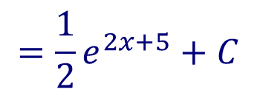
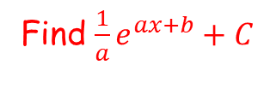

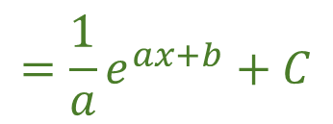

$$\int{e^{ax+b}dx}$$
$$=\frac{1}{a}e^{ax+b}+C$$
Indefinite integrals
$$\int{e^{2x+5}dx}$$
Find the indefinite integral
$$a=2$$
$$b=5$$
Find $\frac{1}{a}e^{ax+b}+C$
$$=\frac{1}{2}e^{2x+5}+C$$

Slide 8
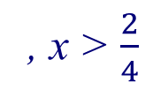
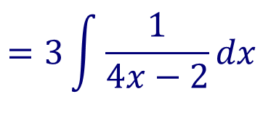
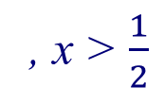


$$\int{\frac{1}{ax+b}dx}$$
$$=\frac{1}{a}\ln{|ax+b|}+C$$
Indefinite integrals
$$\int{\frac{3}{4x−2}dx}$$
Find the indefinite integral
$$a=4$$
$$b=−2$$
$$=3\int{\frac{1}{4x−2}dx}$$
Apply the constant multiple rule
$$=3\left[\frac{1}{4}\ln{(4x−2)}\right]+C$$
, x > $\frac{2}{4}$
Find $\frac{1}{a}\ln{(ax+b)}+C\text{, }\text{x} \text{>} −\frac{b}{a}$
$$=\frac{3}{4}\ln{(4x−2)}+C$$
, x > $\frac{1}{2}$
$$=\frac{3}{4}\ln{|4x−2|}+C$$

Slide 9
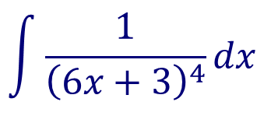
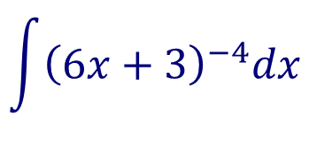
$$\int{{\left(ax+b\right)}^{n}dx}$$
Indefinite integrals
$$\int{\frac{1}{{\left(6x+3\right)}^{4}}dx}$$
Find the indefinite integral
$$a=6$$
$$b=3$$
$$n=−4$$
Rewrite using rational exponents
$$\int{{\left(6x+3\right)}^{−4}dx}$$
Find $\frac{1}{a}\left(\frac{1}{n+1}{\left(ax+b\right)}^{n+1}\right)+C$
$$=\frac{1}{6}\left(\frac{1}{−4+1}{\left(6x+3\right)}^{−4+1}\right)+C$$
$$=\frac{1}{6}\left(\frac{1}{−3}{\left(6x+3\right)}^{−3}\right)+C$$
$$=−\frac{1}{18{\left(6x+3\right)}^{3}}+C$$

Slide 10
Thank you for using resources from
For more resources visit our website
https://www.mathssupport.org
If you have a special request, drop us an email
info@mathssupport.org

