Slide 1
Distance between two points and their midpoint
LO: To calculate the distance between two points in the space and their midpoint.

Slide 2
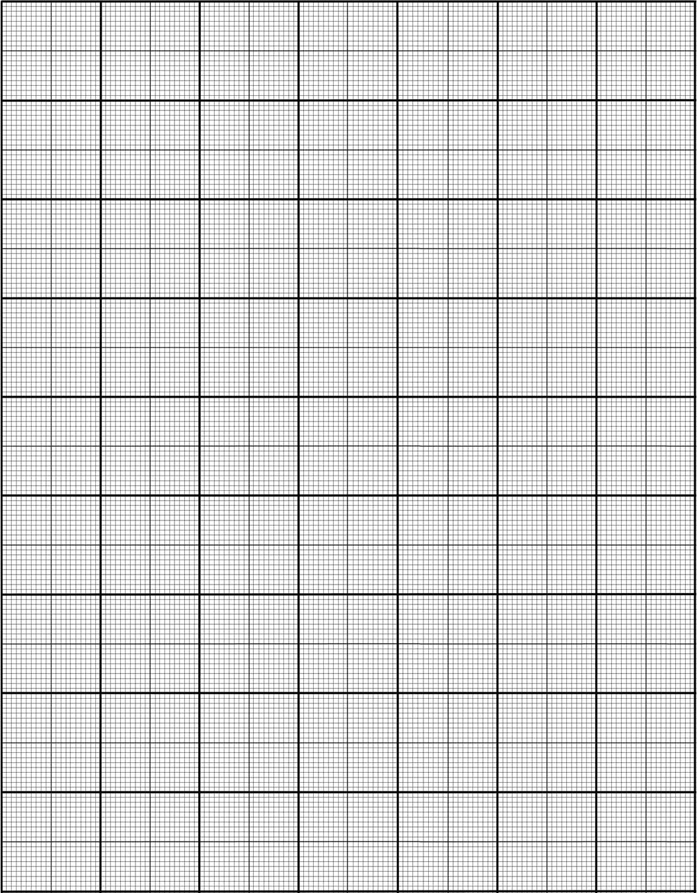
The distance between two points
What is the distance between the points A(-3, –2) and B(3, -2)?
y
D(2, 4)
4
X
3
C(-3, 2)
X
2
The horizontal distance between the points is
1
E(-2, 0)
X
-5
-4
-3
-2
-1
0
1
2
3
4
5
x
3 – (– 3) = 6
-1
X
-2
X
B(3, –2)
A(-3, –2)
-3
The horizontal distance between any pair of horizontal points is
x₂ – x₁

Slide 3
The distance between two points
What is the distance between the points A(-3, –2) and C(–3, 2)?
y
D(2, 4)
4
X
3
C(-3, 2)
X
2
The vertical distance between the points is
1
E(-2, 0)
X
-5
-4
-3
-2
-1
0
1
2
3
4
5
x
-1
2 – (-2) = 4
X
-2
X
B(3, –2)
A(-3, –2)
-3
The vertical distance between any pair of vertical points is .
y₂ – y₁

Slide 4
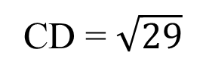
y
The distance between two points
What is the distance between the points C(-3, 2) and D(2, 4)?
y
We can find the distance between them by adding a third point, F, to form a right-angled triangle. We then use Pythagoras’ theorem.
4
X
D(2, 4)
3
2
C(-3, 2)
X
2
X
F(2, 2)
5
1
E(-2, 0)
X
x
-5
-4
-3
-2
-1
0
1
2
3
4
5
Length CF =
2 – (-3)
-1
= 5
A(-3, –2)
Length DF =
4 – 2
X
-2
= 2
-3
Using Pythagoras’ theorem.
CD² = 5² + 2²
CD = $\sqrt{29}$

Slide 5


Generalization for the distance between two points
What is the distance between two general points with coordinates A(x₁, y₁) and B(x₂, y₂)?
The horizontal distance between the points is .
x₂ – x₁
The vertical distance between the points is .
y₂ – y₁
Using Pythagoras’ Theorem, the square of the distance between the points A(x₁, y₁) and B(x₂, y₂) is
$${\left(\overline{AB}\right)}^{2}={\left(x_{2}−x_{1}\right)}^{2}+{\left(y_{2}−y_{1}\right)}^{2}$$
The distance between the points A(x₁, y₁) and B(x₂, y₂) is
$$\overline{AB} =\sqrt{{\left(x_{2}−x_{1}\right)}^{2}+{\left(y_{2}−y_{1}\right)}^{2}}$$

Slide 6

Worked example
Given the coordinates of two points we can use the formula
$$\sqrt{{\left(x_{2}−x_{1}\right)}^{2}+{\left(y_{2}−y_{1}\right)}^{2}}$$
to directly find the distance between them. For example:
What is the distance between the points A(5, –1) and B(–4, 5)?
x₁
y₁
x₂
y₂
A(5, –1) B(–4, 5)

Slide 7





Worked example
Given the coordinates of two points we can use the formula
$$\sqrt{{\left(x_{2}−x_{1}\right)}^{2}+{\left(y_{2}−y_{1}\right)}^{2}}$$
to directly find the distance between them. For example:
What is the distance between the points A(6, 3) and B(8, -2)?
x₁
y₁
x₂
y₂
A(6, 3) B(8, -2)
$$\sqrt{{\left(8−6\right)}^{2}+{\left(−2−3\right)}^{2}}$$
$$=\sqrt{{\left(2\right)}^{2}+{\left(−5\right)}^{2}}$$
$$=\sqrt{4+25}$$
$$=\sqrt{29}$$

Slide 8

Distance between two points in space
If A = (x₁, y₁, z₁)
And G = (x₂, y₂, z₂)
Find the distance AG
z
Using Pythagoras’ theorem
H
AG² = AC² + CG²
E
G
(x₂, y₂, z₂)
z₂
y
AC² = AB² + BC²
z₂ – z₁
F
y₂
z₂ – z₁
D
AG² = AB² + BC² + CG²
A
(x₁, y₁, z₁)
C
x₂ – x₁
y₂ – y₁
AG = $\sqrt{AB2 + BC2 + CG2}$
B
x₂
AG = √
(x₂ – x₁)²
+ (y₂ – y₁)²
+ (z₂ – z₁)²
x
Distance =
$$\sqrt{{\left(x_{2}−x_{1}\right)}^{2}+{\left(y_{2}−y_{1}\right)}^{2}+{\left(z_{2}−z_{1}\right)}^{2}}$$
Notes:
Explain that adding these two vectors is like moving right 5 and up 3 and then moving right 3 and down 2. The net effect is a movement right 8 and up 1. Point out that we can add the horizontal components together to get the horizontal component of the resultant vector (5 + 3 = 8) and we can add the vertical components together to get the vertical component of the resultant vector (3 + –2 = 1).
In the vector diagram the start of vector b is placed at the end of vector a. The resultant vector, a + b, goes from the start of a to the end of b.

Slide 9

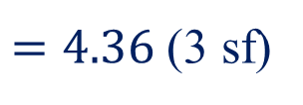


Distance between two points in space
Find the distance from A = (1, 3, 4)
to B = (4, 2, 7)
Distance AB =
$$\sqrt{{\left(3\right)}^{2}+{\left(−1\right)}^{2}+{\left(3\right)}^{2}}$$
$$=\sqrt{9+1+9}$$
$$=\sqrt{19}$$
$=4.36$ (3 sf)
Notes:
Explain that adding these two vectors is like moving right 5 and up 3 and then moving right 3 and down 2. The net effect is a movement right 8 and up 1. Point out that we can add the horizontal components together to get the horizontal component of the resultant vector (5 + 3 = 8) and we can add the vertical components together to get the vertical component of the resultant vector (3 + –2 = 1).
In the vector diagram the start of vector b is placed at the end of vector a. The resultant vector, a + b, goes from the start of a to the end of b.

Slide 10











Distance between two points in space
, B=(2, 6, 5)
and C=(1, 4, 3)
Show that A=(0, 4, 4)
Are vertices of an isosceles triangle.
Distance AB
Distance AC
$$=\sqrt{{\left(2−0\right)}^{2}+{\left(6−4\right)}^{2}+{\left(5−4\right)}^{2}}$$
$$=\sqrt{{\left(1−0\right)}^{2}+{\left(4−4\right)}^{2}+{\left(3−4\right)}^{2}}$$
$$=\sqrt{{\left(2\right)}^{2}+{\left(2\right)}^{2}+{\left(1\right)}^{2}}$$
$$=\sqrt{{\left(1\right)}^{2}+{\left(0\right)}^{2}+{\left(−1\right)}^{2}}$$
$$=\sqrt{4+4+1}$$
$$=\sqrt{1+0+1}$$
$$=\sqrt{9}$$
$$=3$$
$$=\sqrt{2}$$
Distance BC
$$=\sqrt{{\left(1−2\right)}^{2}+{\left(4−6\right)}^{2}+{\left(3−5\right)}^{2}}$$
Since AB = BC ≠ AC
$$=\sqrt{{\left(−1\right)}^{2}+{\left(−2\right)}^{2}+{\left(−2\right)}^{2}}$$
ΔABC is an isosceles triangle.
$$=\sqrt{1+4+4}$$
$$=\sqrt{9}$$
$$=3$$
Notes:
Explain that adding these two vectors is like moving right 5 and up 3 and then moving right 3 and down 2. The net effect is a movement right 8 and up 1. Point out that we can add the horizontal components together to get the horizontal component of the resultant vector (5 + 3 = 8) and we can add the vertical components together to get the vertical component of the resultant vector (3 + –2 = 1).
In the vector diagram the start of vector b is placed at the end of vector a. The resultant vector, a + b, goes from the start of a to the end of b.

Slide 11
A formula for the Mid-Point of AB
y
Mid-point
B
(x₂, y₂)
y₂
X
M X
X
y₁
A
(x₁, y₁)
x
x₁
0
x₂
The mid-point is the average of the end points:
or

Slide 12

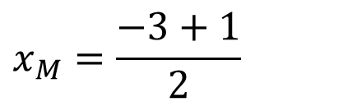


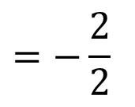
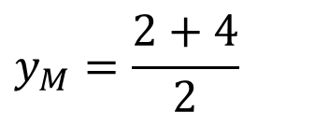
Mid-Point
What are the coordinates of the midpoint between the points C(-3, 2) and D(1, 4)?
y
The mid-point is the average of the end points:
5
D(1, 4)
4
X
MP(-1, 3)
X
3
$$x_{M}=\frac{−3+1}{2}$$
C(-3, 2)
X
2
$$=−\frac{2}{2}$$
$$=−1$$
1
$$y_{M}=\frac{2+4}{2}$$
-5
-4
-3
-2
-1
0
1
2
3
4
5
x
-1
$$=\frac{6}{2}$$
-2
$$=3$$
The coordinates of the midpoint are (-1, 3).

Slide 13
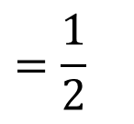
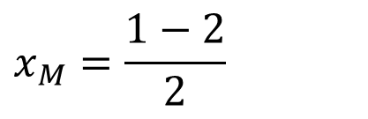
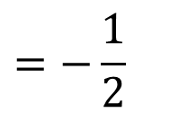
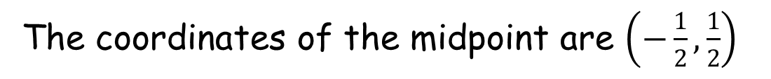

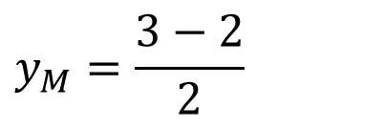
Mid-Point
What are the coordinates of the midpoint between the points A(-2, -2) and B(1, 3)?
y
4
The mid-point is the average of the end points:
B(1, 3)
3
X
2
$$x_{M}=\frac{1−2}{2}$$
MP $\left(−\frac{1}{2}, \frac{1}{2}\right)$
1
X
$$=−\frac{1}{2}$$
-5
-4
-3
-2
-1
0
1
2
3
4
5
x
-1
$$y_{M}=\frac{3−2}{2}$$
X
-2
A(-2, -2)
$$=\frac{1}{2}$$
-3
The coordinates of the midpoint are $\left(−\frac{1}{2}, \frac{1}{2}\right)$

Slide 14
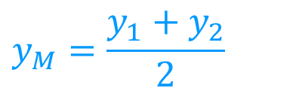
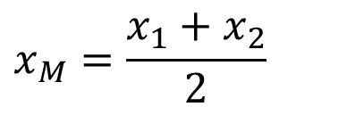
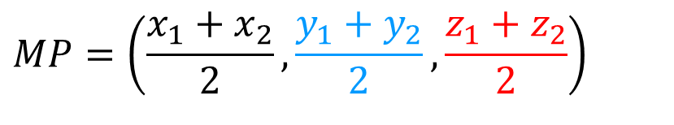
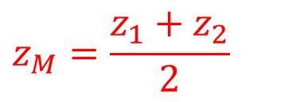
Mid-Point
If A = (x₁, y₁, z₁)
and B = (x₂, y₂, z₂)
The mid-point for 3D coordinates is
$$x_{M}=\frac{x_{1}+x_{2}}{2}$$
$$y_{M}=\frac{y_{1}+y_{2}}{2}$$
$$z_{M}=\frac{z_{1}+z_{2}}{2}$$
$$MP=\left(\frac{x_{1}+x_{2}}{2},\frac{y_{1}+y_{2}}{2},\frac{z_{1}+z_{2}}{2}\right)$$

Slide 15
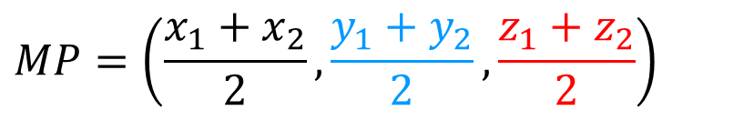
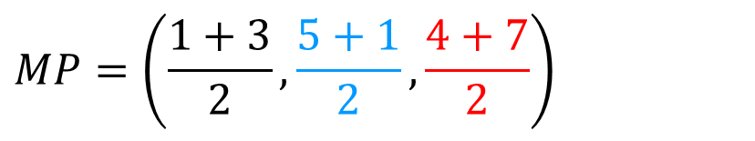
Mid-Point
Find the coordinates of the Midpoint between A = (1, 5, 4)
and B = (3, 1, 7)
$$MP=\left(\frac{x_{1}+x_{2}}{2},\frac{y_{1}+y_{2}}{2},\frac{z_{1}+z_{2}}{2}\right)$$
$$MP=\left(\frac{1+3}{2},\frac{5+1}{2},\frac{4+7}{2}\right)$$
MP = (2, 3, 5.5)
Notes:
Explain that adding these two vectors is like moving right 5 and up 3 and then moving right 3 and down 2. The net effect is a movement right 8 and up 1. Point out that we can add the horizontal components together to get the horizontal component of the resultant vector (5 + 3 = 8) and we can add the vertical components together to get the vertical component of the resultant vector (3 + –2 = 1).
In the vector diagram the start of vector b is placed at the end of vector a. The resultant vector, a + b, goes from the start of a to the end of b.

Slide 16

Thank you for using resources from
For more resources visit our website
https://www.mathssupport.org
If you have a special request, drop us an email
info@mathssupport.org

