Slide 1
Solving quadratic equations (by completing the square)
LO: To solve quadratic equations by completing the square.

Slide 2
Starter
Solve these quadratic equations by factorisation:
x² + 6x + 9 = 0
=(x + 3)(x + 3)
=(x + 3)²
∴
x = –3
x² + 8x + 16 = 0
=(x + 4)(x + 4)
=(x + 4)²
∴
x = –4
x² + 10x + 25 = 0
=(x + 5)(x + 5)
=(x + 5)²
∴
x = –5
x² – 12x + 36 = 0
=(x – 6)(x – 6)
=(x – 6)²
∴
x = 6
x² – 14x + 49 = 0
=(x – 7)(x – 7)
=(x – 7)²
∴
x = 7
x² – 18x + 81 = 0
=(x – 9)(x – 9)
=(x – 9)²
∴
x = 9

Slide 3
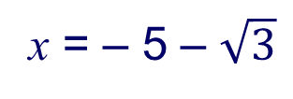
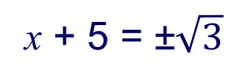
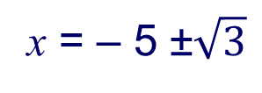
Solving quadratics by completing the square
Some Quadratic equations cannot be solved by factorization.
There are other methods to solve quadratic equation without using the GDC
For example, the quadratic equation,
x² + 10x + 25 = 3
( )
If we collect all the terms on one side of the equation, we get
x² + 10x + 22 = 0
Which does not factorise easily, so we can use a different method
Factorising the perfect square trinomial:
(x + 5)² = 3
Taking the square root of both sides:
x + 5 = ±$\sqrt{3}$
Rearranging for x:
x = – 5 ±$\sqrt{3}$
x has two solutions
x = – 5 + √3
or
x = – 5 – $\sqrt{3}$
This method is called completing the square

Slide 4
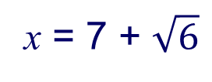
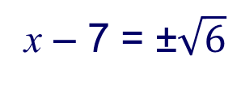
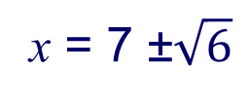
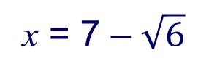
Solving quadratics by completing the square
Solve the quadratic equation,
x² – 14x + 49 = 6
( )
We can see easily that in the left hand side we have a “perfect square trinomial”
We are going to use the method “Completing the square”
Factorising the perfect square trinomial:
(x – 7)² = 6
Taking the square root of both sides:
x – 7 = ±$\sqrt{6}$
Rearranging for x:
x = 7 ±$\sqrt{6}$
x has two solutions
x = 7 + $\sqrt{6}$
or
x = 7 – $\sqrt{6}$
Giving the answers in surd form gives the exact solutions

Slide 5
Solving quadratics by completing the square
Solve the quadratic equation,
6
x² + 6x = 5
We can see that in the left hand side we do not have a “perfect square trinomial” but we can make it.
Which number is needed to have a perfect square trinomial on the left hand side?
Halve the coefficient of x
= 3
Square it
= 9
If we add 9 in both sides the equation does not change
x² + 6x + 9 = 5 + 9
And we have a “perfect square trinomial” on the left
x² + 6x + 9 = 14
Factorising the perfect square trinomial:
(x + 3)² = 14
Taking the square root of both sides:
x + 3 = ±$\sqrt{14}$
Rearranging for x:
x = – 3 ±$\sqrt{14}$
x has two solutions
x = – 3 + √14
or
x = – 3 – $\sqrt{14}$
Giving the answers in surd form gives the exact solutions

Slide 6
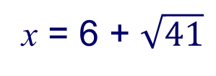
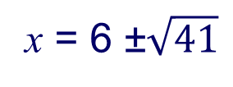
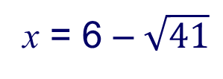
Solving quadratics by completing the square
Solve the quadratic equation,
12
x² – 12x = 5
We can see that in the left hand side we do not have a “perfect square trinomial” but we can make it.
Which number is needed to have a perfect square trinomial on the left hand side?
Halve the coefficient of x
= 6
Square it
= 36
If we add 36 in both sides the equation does not change
x² – 12x + 36 = 5 + 36
And we have a “perfect square trinomial” on the left
x² – 12x + 36 = 41
Factorising the perfect square trinomial:
(x – 6)² = 41
Taking the square root of both sides:
x – 6 = ±$\sqrt{41}$
Rearranging for x:
x = 6 ±$\sqrt{41}$
x has two solutions
x = 6 + $\sqrt{41}$
or
x = 6 – $\sqrt{41}$
Giving the answers in surd form gives the exact solutions

Slide 7
Solving quadratics by completing the square
Solve the quadratic equation,
x² + 8x + 5 = 0
Rearranging to leave all the terms with x on the left-hand side,
x² + 8x = – 5
Completing the square on the left-hand side,
Halve the coefficient of x, square it and add to both sides
x² + 8x + 16 = – 5 + 16
x² + 8x + 16 = 11
Factorising the perfect square trinomial:
(x + 4)² = 11
square root both sides:
x + 4 = ±$\sqrt{11}$
Rearranging for x:
x = – 4 ±$\sqrt{11}$
x = –4 + $\sqrt{11}$
or
x = –4 – $\sqrt{11}$

Slide 8
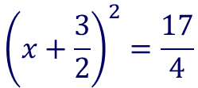
Solving quadratics by completing the square
Solve the quadratic equation,
x² + 3x – 2 = 0
Rearranging to leave all the terms with x on the left-hand side,
x² + 3x = 2
Completing the square on the left-hand side,
Which number is needed to have a perfect square trinomial on the left hand side?
Halve the coefficient of x
=
$$\frac{3}{2}$$
Square it
=
$$\frac{9}{4}$$
$$\frac{9}{4}$$
If we add in both sides the equation does not change
$$\frac{9}{4}$$
$$\frac{9}{4}$$
⇒
$$\frac{9}{4}$$
$$\frac{17}{4}$$
x² + 3x + = 2 +
x² + 3x + =
And we have a “perfect square trinomial” on the left
$${\left(x+\frac{3}{2}\right)}^{2}=\frac{17}{4}$$
Factorising the perfect square trinomial:
$$x+\frac{3}{2}=\frac{±\sqrt{17}}{2}$$
square root both sides:
$$x=\frac{−3±\sqrt{17}}{2}$$
Rearranging for x:
$$x=\frac{−3+\sqrt{17}}{2}$$
$$x=\frac{−3−\sqrt{17}}{2}$$
or

Slide 9
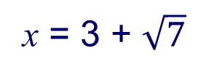
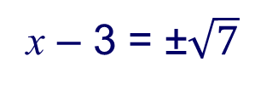
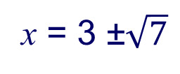
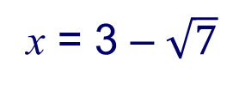
Solving quadratics by completing the square
In order to complete the square, the coefficient of the x² term must be 1
If the x² term has a coefficient other than 1, before completing the square, you can divide through by the coefficient, or factor out the coefficient.
Solve the equation 2x² – 12x + 4 = 0
We can complete the square for 2x² – 12x + 4 by first dividing both sides of the equation by the coefficient of x², which is 2
x² – 6x + 2 = 0
Rearranging to leave all the terms with x on the left-hand side:
x² – 6x = – 2
Completing the square on the left-hand side:
x² – 6x + 9 = – 2 + 9
x² – 6x + 9 = 7
Factorising the perfect square trinomial:
(x – 3)² = 7
square root both sides:
x – 3 = ±$\sqrt{7}$
Rearranging for x:
x = 3 ±$\sqrt{7}$
x = 3 + $\sqrt{7}$
or
x = 3 – $\sqrt{7}$

Slide 10
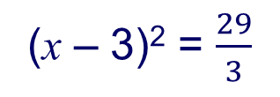

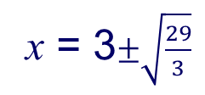
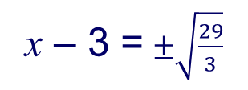
Solving quadratics by completing the square
Solve the equation 3x² – 18x = 2
We can complete the square for 3x² – 18x = 2 by first factorise the left-hand side of the equation
3(x² – 6x) = 2
Rearranging to leave all the terms with x on the left-hand side:
x² – 6x = $\frac{2}{3}$
x² – 6x + 9 = $\frac{2}{3}$ + 9
Completing the square on the left-hand side:
x² – 6x + 9 = $\frac{29}{3}$
Factorising the perfect square trinomial:
(x – 3)² = $\frac{29}{3}$
x – 3 = $±\sqrt{\frac{29}{3}}$
square root both sides:
x = 3$±\sqrt{\frac{29}{3}}$
Rearranging for x:
This answer can also be written as
x =
$$\frac{9±\sqrt{87}}{3}$$

Slide 11
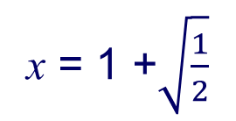
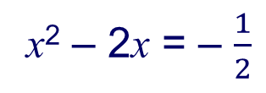
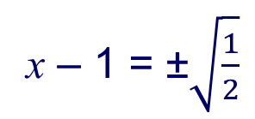
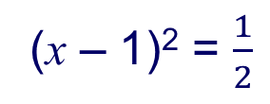
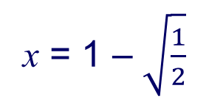
Solving quadratics by completing the square
Solve the equation 2x² – 4x + 1 = 0 by completing the square. Write the answer to 3 decimal places.
2x² – 4x + 1 = 0
Rearranging to leave all the terms with x on the left-hand side:
2x² – 4x = –1
2(x² – 2x) = –1
factorise the left-hand side
divide both sides by 2:
x² – 2x = – $\frac{1}{2}$
completing the square:
x² – 2x + 1 = – $\frac{1}{2}\text{+ 1}$
(x – 1)² = $\frac{1}{2}$
Factorising the perfect square in the left-hand side:
x – 1 = ±$\sqrt{\frac{1}{2}}$
square root both sides:
x = 1 +$\sqrt{\frac{1}{2}}$
x = 1 – $\sqrt{\frac{1}{2}}$
or
x = 1.707
x = 0.293 (to 3 d. p)

Slide 12
Thank you for using resources from
For more resources visit our website
https://www.mathssupport.org
If you have a special request, drop us an email
info@mathssupport.org

