Slide 1
Factorial notation
LO: To understand and use the factorial notation to simplify expressions.

Slide 2
Factorial notation
Some mathematical problem about arrangements and combinations involve large numbers so you will need to develop a number of counting techniques.
Look at the first four terms of this sequence
$$u0=1$$
$$u0=1$$
u₁ = 1 × u₀
= 1
u_{n} :
u_{n} = n × u_{n-1}
u₂ = 2 × u₁
= 2 × 1
u₃ = 3 × u₂
= 3 × 2 × 1
The general term of this sequence is:
u_{n} = n ×
(n – 1) ×
(n – 2) ×
…
× 3 × 2 × 1
A simpler way to denote this sequence is to use factorial notation where
u_{n} = n!

Slide 3
Factorial notation
$$u0=1$$
u_{n} :
u_{n} = n × u_{n-1}
u_{n} = n!
u_{o} = 0!
It follows that
= 1
u₁ = 1!
= 1
$$=1 \text{×} \text{0!}$$
u₂ = 2!
= 2 × 1
$$=2 \text{×} \text{1!}$$
u₃ = 3!
= 3 × 2 × 1
$$=3 \text{×} \text{2!}$$
u₄ = 4!
= 4 × 3 × 2 × 1
$$=4 \text{×} \text{3!}$$
n! is the product of the first n positive integers
n! = n ×
(n – 1) ×
(n – 2) ×
…
× 3 × 2 × 1
The factorial rule is:
n! = n ×
(n – 1)!
Which can be extended to
n! = n
(n – 1) (n – 2)!

Slide 4
Using factorial
Example 1:
Evaluate
5!
5!
= 5 × 4 × 3 × 2 × 1
= 120
Example 2:
$$\frac{7!}{4!}$$
Evaluate
$$\frac{7!}{4!}$$
$$=\frac{7×6×5×4×3×2×1}{4×3×2×1}$$
= 210

Slide 5
Using factorial
Example 3:
$$\frac{7!}{4!×3!}$$
Evaluate
$$=\frac{7×6×5×4×3×2×1}{4×3×2×1 }$$
× 3 × 2 × 1
$$=\frac{210}{6}$$
= 35

Slide 6
Using factorial
Example 4:
Simplify the expressions
8! + 6!
= 8 × 7 × 6! + 6!
= 56 × 6! + 6!
Factorising
= 6! (56 + 1)
= 6! (57)
Simplify the expressions
Example 5:
10! – 9! + 8!
= 10 × 9 × 8! – 9 × 8! + 8!
= 90 × 8! – 9 × 8! + 8!
Factorising
= 8! (90 – 9 + 1)
= 8! (82)

Slide 7
Using factorial
Example 6:
$$\frac{10!+9!}{11}$$
Simplify
$$=\frac{10×9!+9!}{11 }$$
$$=\frac{9!(10+1)}{11}$$
Factorising
$$=\frac{9!(11)}{11}$$
= 9!

Slide 8
Pascal’s triangle
LO: Use The Pascal’s triangle to find the coefficients of a binomial expansion.

Slide 9
Pascal’s triangle
We will look at a famous mathematical pattern known as Pascal’s triangle
Pascal’s triangle is named after Blaise Pascal ( French mathematician)
To generate the numbers in the triangle we start at the top and add pairs of numbers to get the next row
1
1
1
2
1
1
3
3
1
1
4
6
4
1
1
5
10
10
5
1
1
6
15
20
15
6
1

Slide 10
Pascal’s triangle
We will look at a famous mathematical pattern known as Pascal’s triangle
Pascal’s triangle is named after Blaise Pascal ( French mathematician)
The numbers in each row can be found using combinations
1
1
n = 1
1
2
1
n = 2
Or using the _{n}C_{r} function on the GDC
1
3
3
1
n = 3
1
4
6
4
1
n = 4
Where n stand for the number of the row
1
5
10
10
5
1
n = 5
1
6
15
20
15
6
1
n = 6
r=0
r=1
r=2
r=3
r=4
r=5
r=6
and r stand for the position of the term in the row starting with 0

Slide 11
Pascal’s triangle
We will look at a famous mathematical pattern known as Pascal’s triangle
Pascal’s triangle is named after Blaise Pascal ( French mathematician)
Lets calculate the values of the row number 4.
1
1
1
2
1
Using the _{n}C_{r} function on the GDC
1
3
3
1
1
4
6
4
1
n = 4
r=0
r=1
r=2
r=3
r=4
and r will be, 0, 1, 2, 3 and 4
n is 4
1
5
10
10
5
1
1
6
15
20
15
6
1
Lets use the _{n}C_{r} function on the GDC to calculate the first value when r = 0

Slide 12
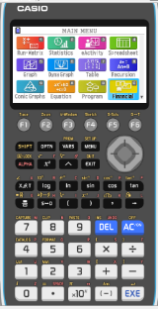
Using a GDC
Use your GDC to calculate the first value in the row 4 when n = 4 and r = 0
We are going to use Graphing display calculator to find this value
Click on the calculator you are using
CASIO
Texas Instruments

Slide 13
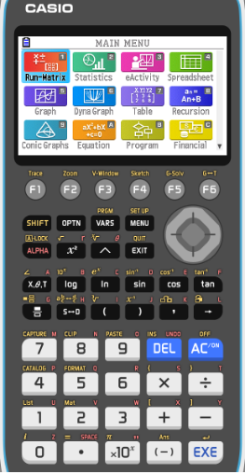
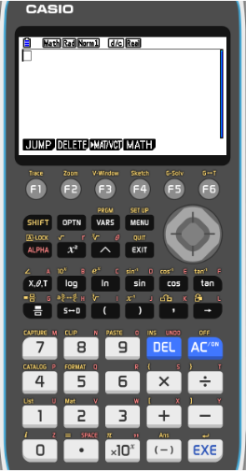
Pascal’s triangle
Use your GDC to calculate the first value in the row 4 when n = 4 and r = 0
Go to MENU in the GDC
RUN-MAT [1]
EXE
OPTN

Slide 14
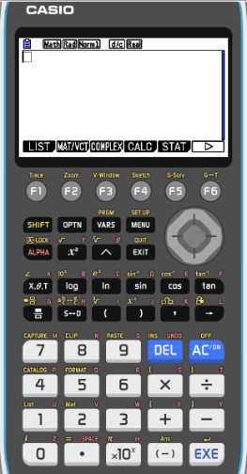
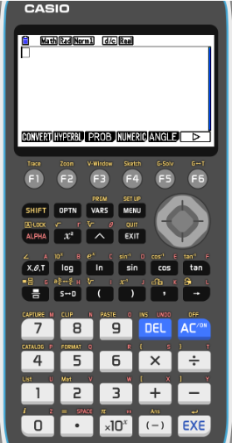
Pascal’s triangle
Use your GDC to calculate the first value in the row 4 when n = 4 and r = 0
Go to MENU in the GDC
RUN-MAT [1]
EXE
OPTN
F6
F3
PROB

Slide 15
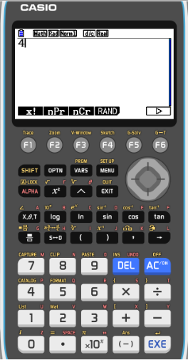
Pascal’s triangle
Use your GDC to calculate the first value in the row 4 when n = 4 and r = 0
Go to MENU in the GDC
RUN-MAT [1]
EXE
OPTN
F6
F3
PROB
4
F3
nCr

Slide 16
Pascal’s triangle
Use your GDC to calculate the first value in the row 4 when n = 4 and r = 0
Go to MENU in the GDC
RUN-MAT [1]
EXE
OPTN
F6
F3
PROB
4
F3
nCr
0
00
EXE

Slide 17
Pascal’s triangle
Use your GDC to calculate the first value in the row 4 when n = 4 and r = 0
Go to MENU in the GDC
RUN-MAT [1]
EXE
OPTN
F6
F3
PROB
4
F3
Click here for the Next
nCr
0
EXE

Slide 18
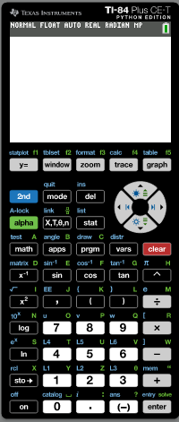
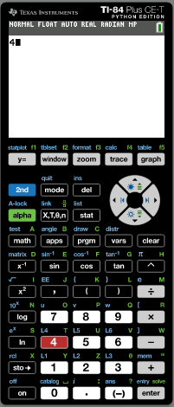
Pascal’s triangle
Use your GDC to calculate the first value in the row 4 when n = 4 and r = 0
Turn on the GDC
Press 4
Press [MATH]

Slide 19
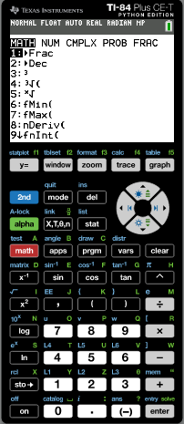
Pascal’s triangle
Use your GDC to calculate the first value in the row 4 when n = 4 and r = 0
Turn on the GDC
Press 4
Press [MATH]
arrow right to highlight PROB

Slide 20
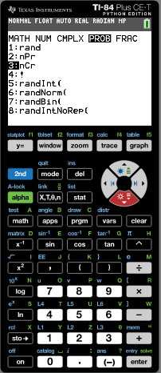
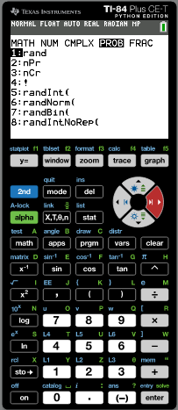
Pascal’s triangle
Use your GDC to calculate the first value in the row 4 when n = 4 and r = 0
Turn on the GDC
Press 4
Press [MATH]
arrow right to highlight PROB
press [3] to select the nCr function

Slide 21
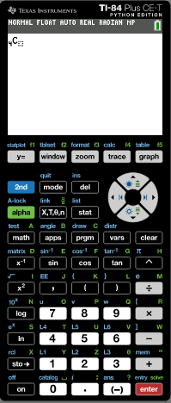
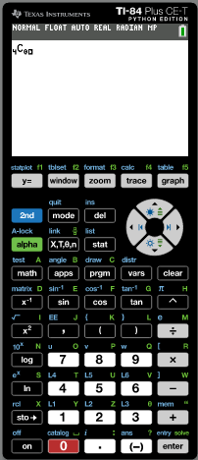
Pascal’s triangle
Use your GDC to calculate the first value in the row 4 when n = 4 and r = 0
Turn on the GDC
Press 4
Press [MATH]
arrow right to highlight PROB
press [3] to select the nCr function
Press 0
Enter

Slide 22
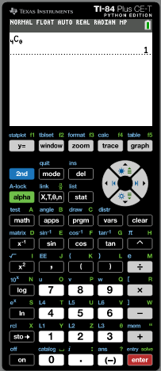
Pascal’s triangle
Use your GDC to calculate the first value in the row 4 when n = 4 and r = 0
Turn on the GDC
Press 4
Press [MATH]
arrow right to highlight PROB
press [3] to select the nCr function
Press 0
Enter
Click here for the Next

Slide 23
Pascal’s triangle
We will look at a famous mathematical pattern known as Pascal’s triangle
Pascal’s triangle is named after Blaise Pascal ( French mathematician)
Lets calculate the values of the row number 4.
1
1
1
2
1
Using the _{n}C_{r} function on the GDC
1
3
3
1
1
4
6
4
1
n = 4
r=0
r=1
r=2
r=3
r=4
n is 4 and r will be, 0, 1, 2, 3 and 4
1
5
10
10
5
1
1
6
15
20
15
6
1
₄C₀=1
₄C₁=4
Now use the _{n}C_{r} function on the GDC to calculate the second value when r = 1

Slide 24
Pascal’s triangle
We will look at a famous mathematical pattern known as Pascal’s triangle
Pascal’s triangle is named after Blaise Pascal ( French mathematician)
Lets calculate the values of the row number 4.
1
1
1
2
1
Using the _{n}C_{r} function on the GDC
1
3
3
1
1
4
6
4
1
n = 4
r=0
r=1
r=2
r=3
r=4
n is 4 and r will be, 0, 1, 2, 3 and 4
1
5
10
10
5
1
1
6
15
20
15
6
1
₄C₀=1
₄C₁=4
₄C₂=6
Now use the _{n}C_{r} function on the GDC to calculate the third value when r = 2

Slide 25
Pascal’s triangle
We will look at a famous mathematical pattern known as Pascal’s triangle
Pascal’s triangle is named after Blaise Pascal ( French mathematician)
Lets calculate the values of the row number 4.
1
1
1
2
1
Using the _{n}C_{r} function on the GDC
1
3
3
1
1
4
6
4
1
n = 4
r=0
r=1
r=2
r=3
r=4
n is 4 and r will be, 0, 1, 2, 3 and 4
1
5
10
10
5
1
1
6
15
20
15
6
1
₄C₀=1
₄C₁=4
₄C₂=6
₄C₃=4
Now use the _{n}C_{r} function on the GDC to calculate the fourth value when r = 3

Slide 26
Pascal’s triangle
We will look at a famous mathematical pattern known as Pascal’s triangle
Pascal’s triangle is named after Blaise Pascal ( French mathematician)
Lets calculate the values of the row number 4.
1
1
1
2
1
Using the _{n}C_{r} function on the GDC
1
3
3
1
1
4
6
4
1
n = 4
r=0
r=1
r=2
r=3
r=4
n is 4 and r will be, 0, 1, 2, 3 and 4
1
5
10
10
5
1
1
6
15
20
15
6
1
₄C₀=1
₄C₁=4
₄C₂=6
₄C₃=4
₄C₄ = 1
Now use the _{n}C_{r} function on the GDC to calculate the fifth value when r = 4

Slide 27
Pascal’s triangle
_{n}C_{r} is commonly written as or sometimes as
$$\left(\begin{matrix}n \\ r\end{matrix}\right)$$
$$C\begin{matrix}n \\ r\end{matrix}$$
The meaning is the number of ways n items can be taken r at a time.
The number of combinations of n items taken r at a time is found by:
$$=\frac{n!}{r!\left(n−r\right)!}$$
_{n}C_{r}
$$=\left(\begin{matrix}n \\ r\end{matrix}\right)$$
Where n! = n x (n – 1) x (n – 2) x … x 1
! Is the factorial sign. n! is called n factorial

Slide 28
Pascal’s triangle
Find the value of
₇C₅
$$=\frac{n!}{r!\left(n−r\right)!}$$
_{n}C_{r}
$$=\left(\begin{matrix}n \\ r\end{matrix}\right)$$
Using the formula:
Substitute n = 7 and r = 5 into the formula:
$$=\frac{7!}{5!\left(7−5\right)!}$$
$$\left(\begin{matrix}7 \\ 5\end{matrix}\right)$$
Expanding:
$$=\frac{7×6×5×4×3×2×1}{(5×4×3×2×1)\left(2×1\right)}$$
Canceling out like factors:
$$=\frac{7×6}{2×1 }$$
$$=\frac{42}{2}$$
= 21

Slide 29
Thank you for using resources from
For more resources visit our website
https://www.mathssupport.org
If you have a special request, drop us an email
info@mathssupport.org

