Slide 1
Introduction to vectors
LO: To know and use correct notation for vectors.

Slide 2
Vectors and scalars
A vector is a quantity that has both size (or magnitude) and direction.
Examples of vector quantities are:
displacement
velocity
weight
A scalar is a quantity that has size (or magnitude) but not direction.
Examples of scalar quantities are:
distance
speed
mass

Slide 3
Representing vectors
A vector can be represented using directed line segments with an arrow on it.
For example,
B
A
The magnitude of the vector is given by the length of the line.
The direction of the vector is given by the arrow on the line.

Slide 4
Representing vectors
5
B
4
a
3
2
1
A
0
1
2
3
4
5
6
7
8
This vector goes from the point A to the point B.
We can write this vector as AB.
Vectors can also be written using single lower case bold letters.
For example, we can call this vector a.
a
a
When this is hand-written, the a is written as or
Notes:
This example shows the vector from point A to point B. Ask pupils to suggest ways to describe this vector. For example, we could express it in terms of a movement through a given number of units up and to the right. We could also describe it in term of the length of the line and the angle it is moved through, as we do with bearings.
Stress that when a is hand-written we must put a squiggle underneath to show that it is a vector.

Slide 5
Representing vectors
5
B
4
3
3
2
1
A
6
0
1
2
3
4
5
6
7
8
To go from the point A to the point B we must move 6 units to the right and 3 units up.
We can represent this movement using a column vector.
This is the horizontal component. It tells us the number of units in the x-direction.
6
AB
=
3
This is the vertical component. It tells us the number of units in the y-direction.
Notes:
Explain that, as with coordinates, movements to the right are positive, movements to the left are negative, movements up are positive and movements down are negative.
Link this to work done on transformations.

Slide 6
Representing vectors
5
B
4
j
3
3j
j
2
j
1
A
i
i
i
i
i
i
6i
0
1
2
3
4
5
6
7
8
The vector can be represented in unit vector form.
The unit vector in the direction of x-axis is i and is a vector of length 1 unit in the direction of x
The base vector in the direction of y-axis is j and is a vector of length 1 unit in the direction of y
6
We can write as 6i + 3j
3
Notes:
Explain that, as with coordinates, movements to the right are positive, movements to the left are negative, movements up are positive and movements down are negative.
Link this to work done on transformations.

Slide 7
Representing vectors
We can also think about objects that move around in a three dimensional space. We can represent a vector in three dimensions.
In three dimensions the unit vector in the direction of the z-axis is k.
So, k and is a vector of length 1 unit in the
direction of z.
So now we have three components
3
We can write as 3i – 2j + k
-2
1
Represents a movement of 3 units in the positive x-direction, 2 units in the negative y-direction and 1 unit in the positive
z-direction
The vectors, i, j, k are called base vectors
Notes:
Explain that, as with coordinates, movements to the right are positive, movements to the left are negative, movements up are positive and movements down are negative.
Link this to work done on transformations.

Slide 8
Unit vectors
The unit vector in the direction of x-axis is i .
1
1
i =
In two dimensions
i
=
in three dimensions
0
0
0
The unit vector in the direction of y-axis is j .
0
0
j =
In two dimensions
j
=
in three dimensions
1
1
0
0
In three dimensions the unit vector in the direction of z-axis is k .
k =
0
1
Notes:
Explain that, as with coordinates, movements to the right are positive, movements to the left are negative, movements up are positive and movements down are negative.
Link this to work done on transformations.

Slide 9
Representing vectors
Examples:
5
a
=
Write in unit vector form
-4
a = 5i – 4j
Write b = -2i + 3k in column vector form
-2
b =
Here the coefficient of the j component is zero
0
3
Notes:
Explain that, as with coordinates, movements to the right are positive, movements to the left are negative, movements up are positive and movements down are negative.
Link this to work done on transformations.

Slide 10
Equal vectors
Two vectors are equal if they have the same direction and the same magnitude.
Their i, j, k components are equal too
Their column vectors are equal.
Which of these vectors are equal?
Are pointing in the same direction
∴ a =
b =
g
Have the same magnitude
a
g
c
d
e
b
f
Notes:
Point out that equal vectors can be anywhere on the grid.

Slide 11
Negative vectors
What we can say about vector a and c?.
Have the same magnitude
Are pointing in different directions
∴ a ≠
c
2
-2
- c
a
=
c
=
and so a =
3
-3
c is called the negative vector
a
g
c
d
e
b
f
Notes:
Point out that equal vectors can be anywhere on the grid.

Slide 12
Parallel vectors
What we can say about vector a, d and e?.
Have different magnitudes
Two vectors are Parallel if one is a scalar multiple of the other
Are pointing in the same direction
2
4
1
a
=
d
=
e
=
3
6
1.5
We can say that a = kb
$$\frac{1}{2}$$
and so a =
d
2e
and a =
c we can say that the vectors are parallel
a
g
c
d
e
b
f
Notes:
Point out that equal vectors can be anywhere on the grid.

Slide 13
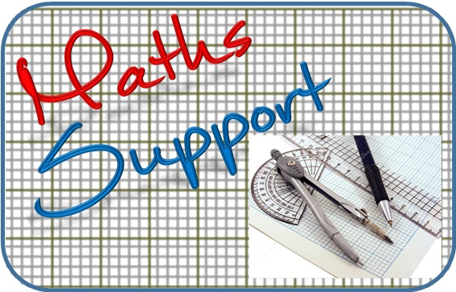
Thank you for using resources from
For more resources visit our website
https://www.mathssupport.org
If you have a special request, drop us an email
info@mathssupport.org

